Slide 1
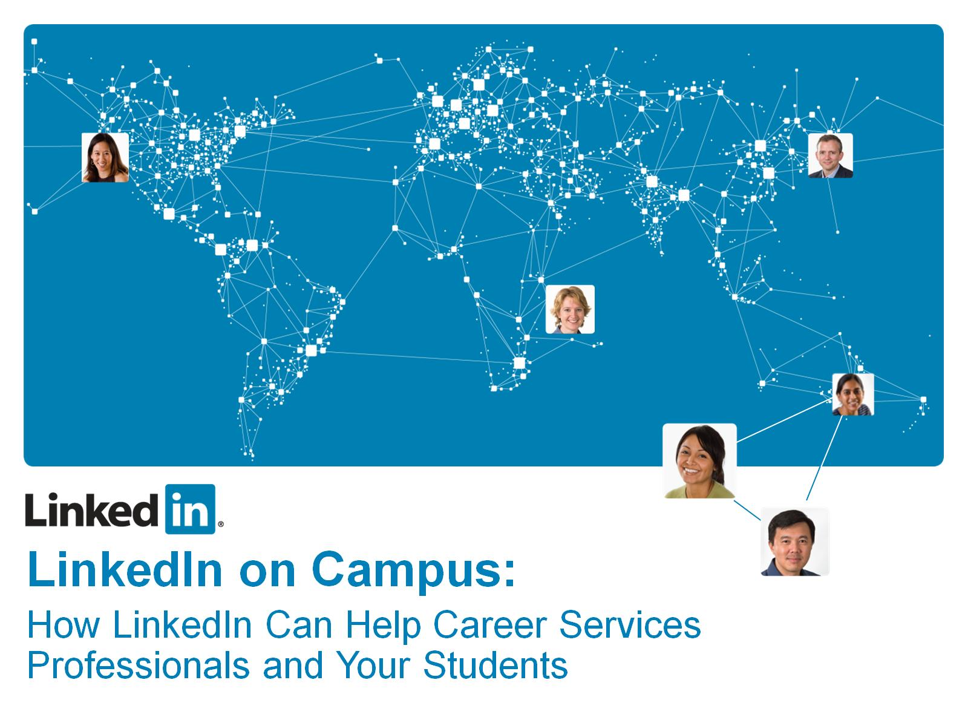

Slide 2


Slide 3
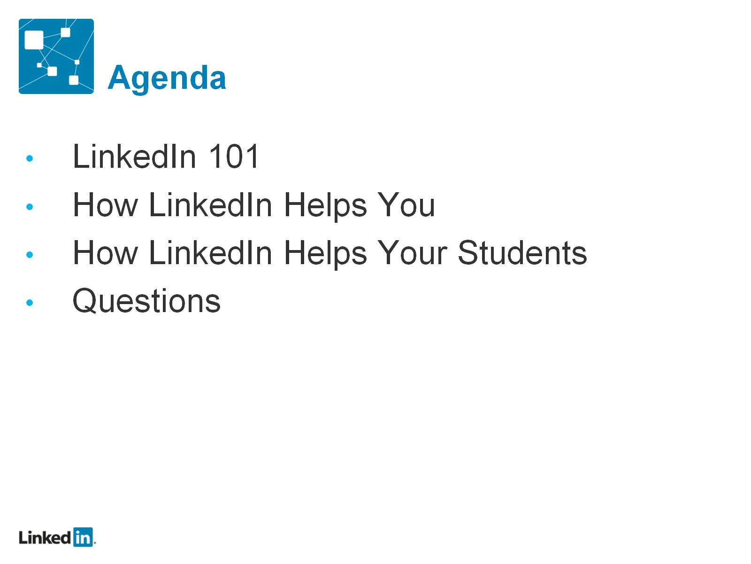
Agenda

Slide 4
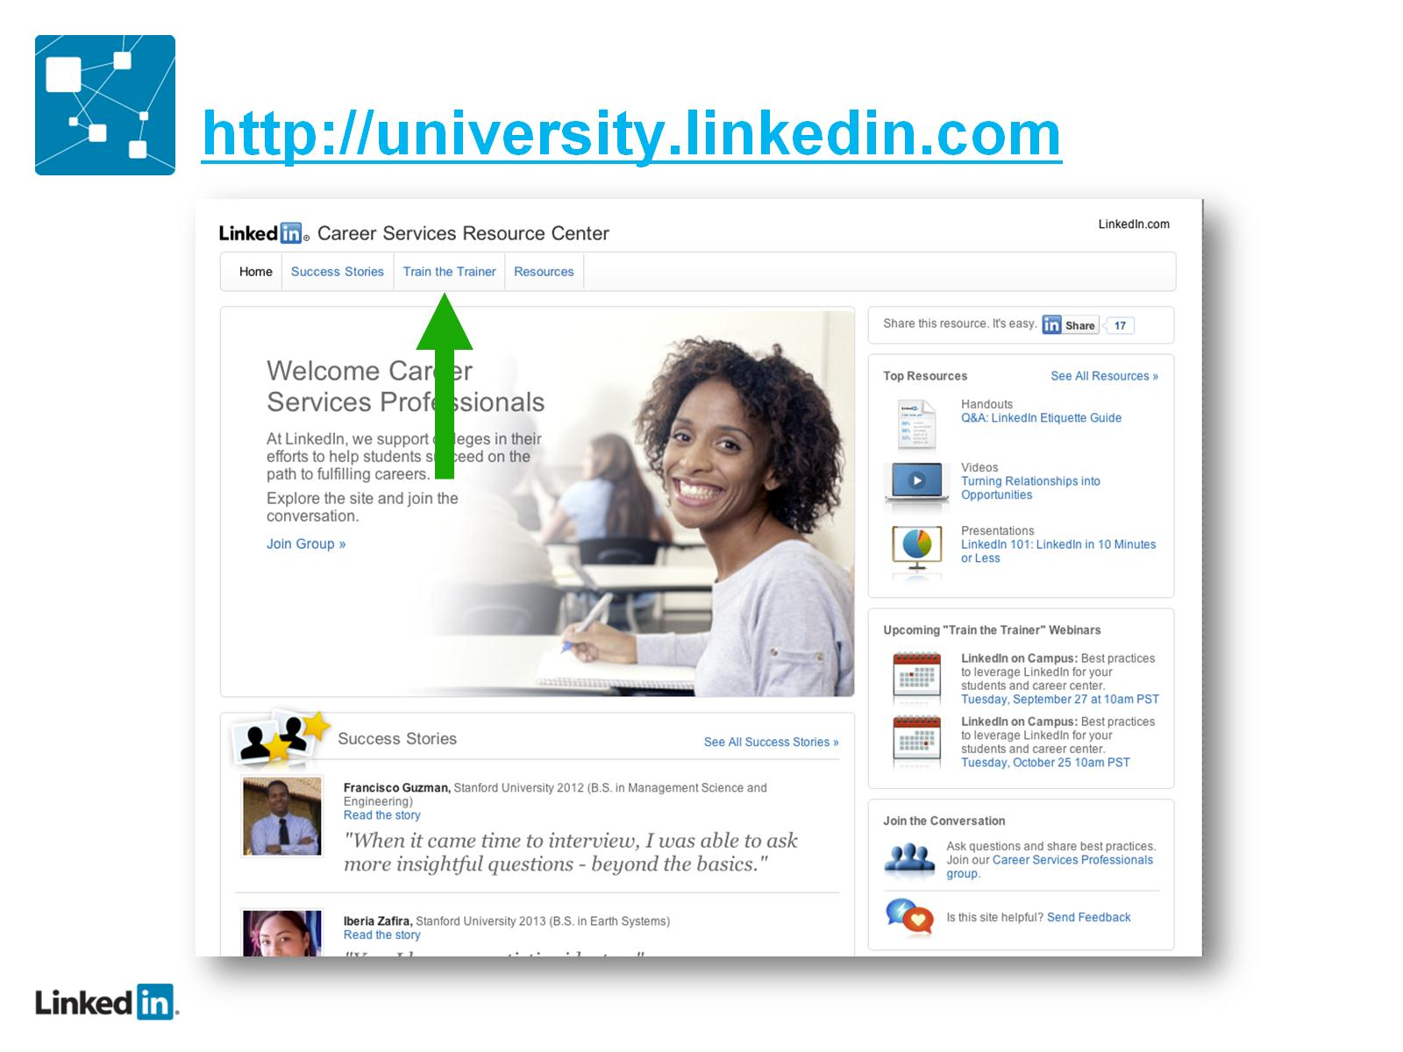
http://university.linkedin.com

Slide 5
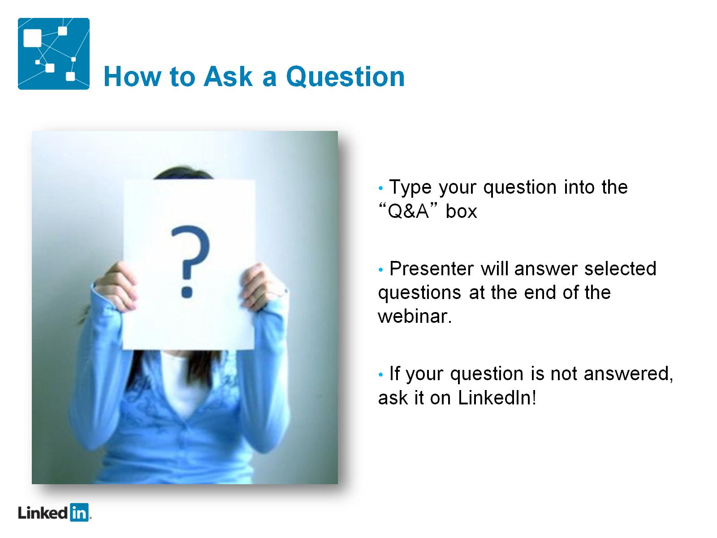
How to Ask a Question

Slide 6
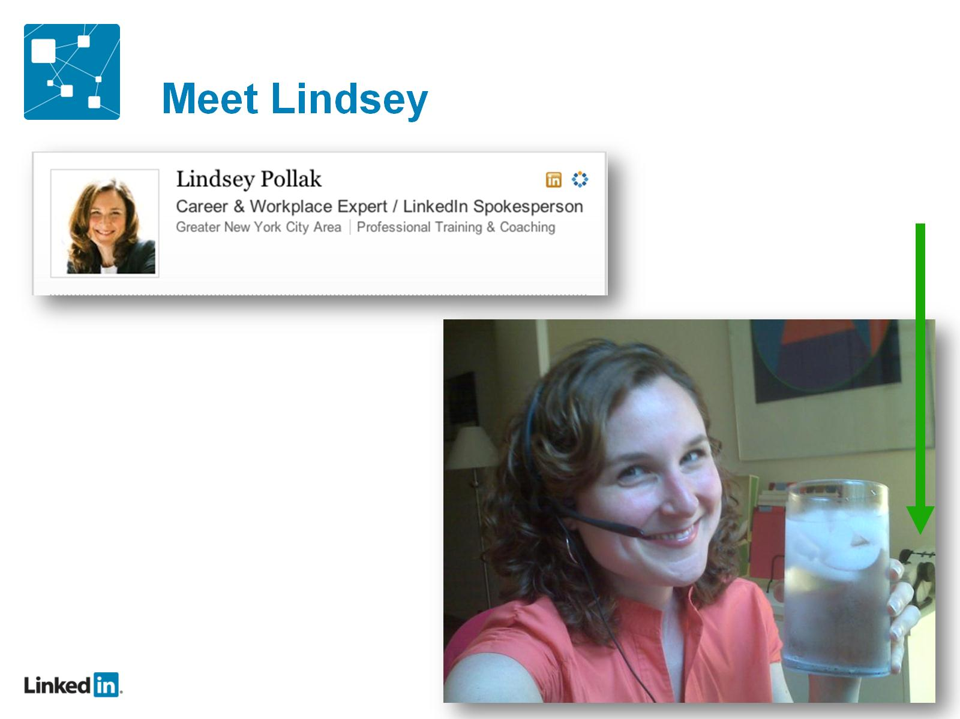
Meet Lindsey

Slide 7
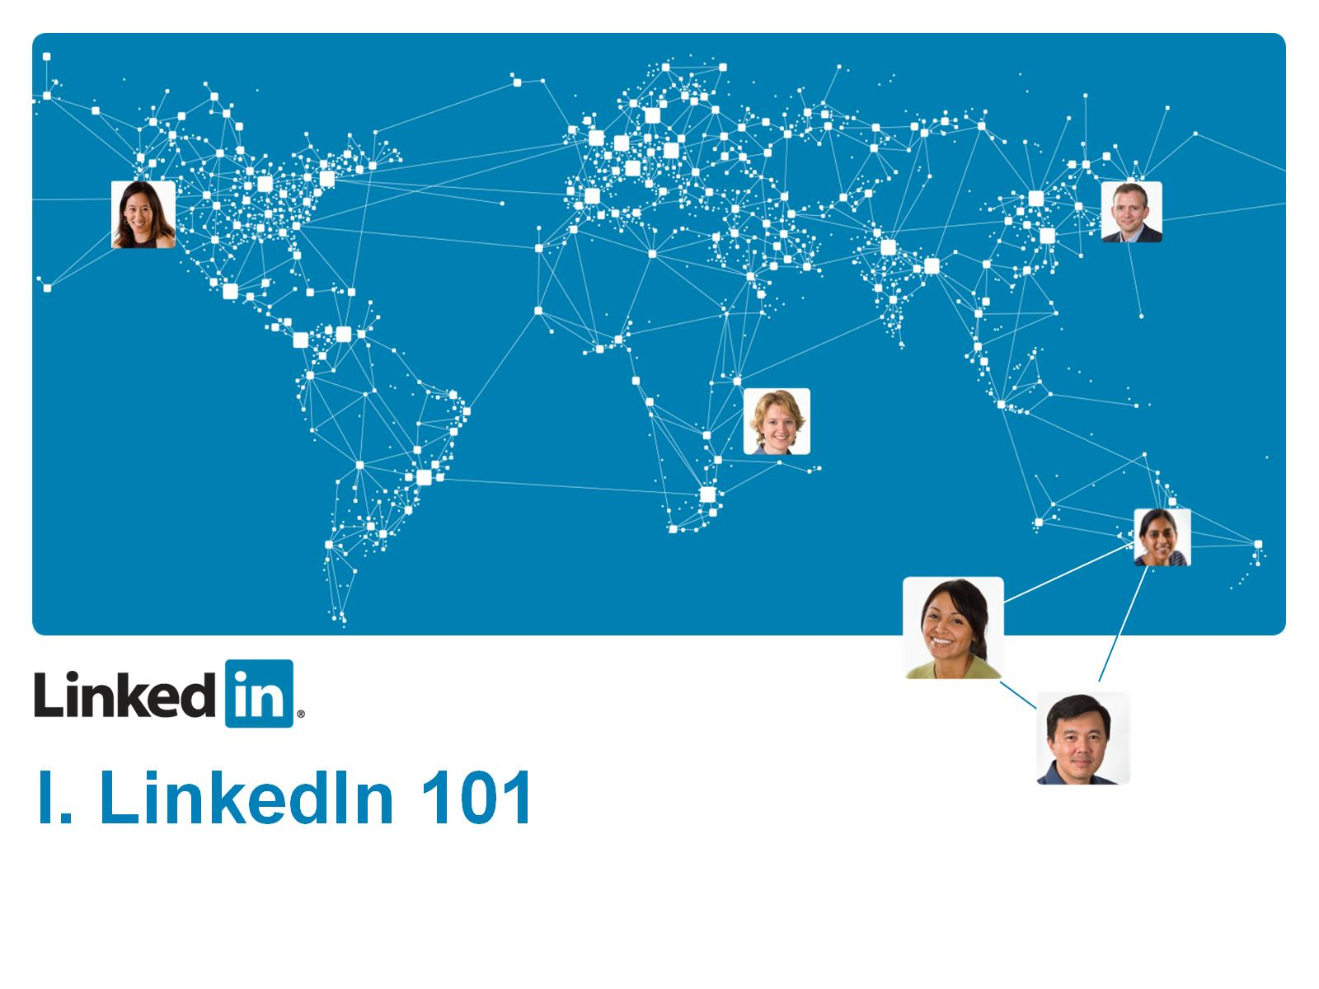

Slide 8
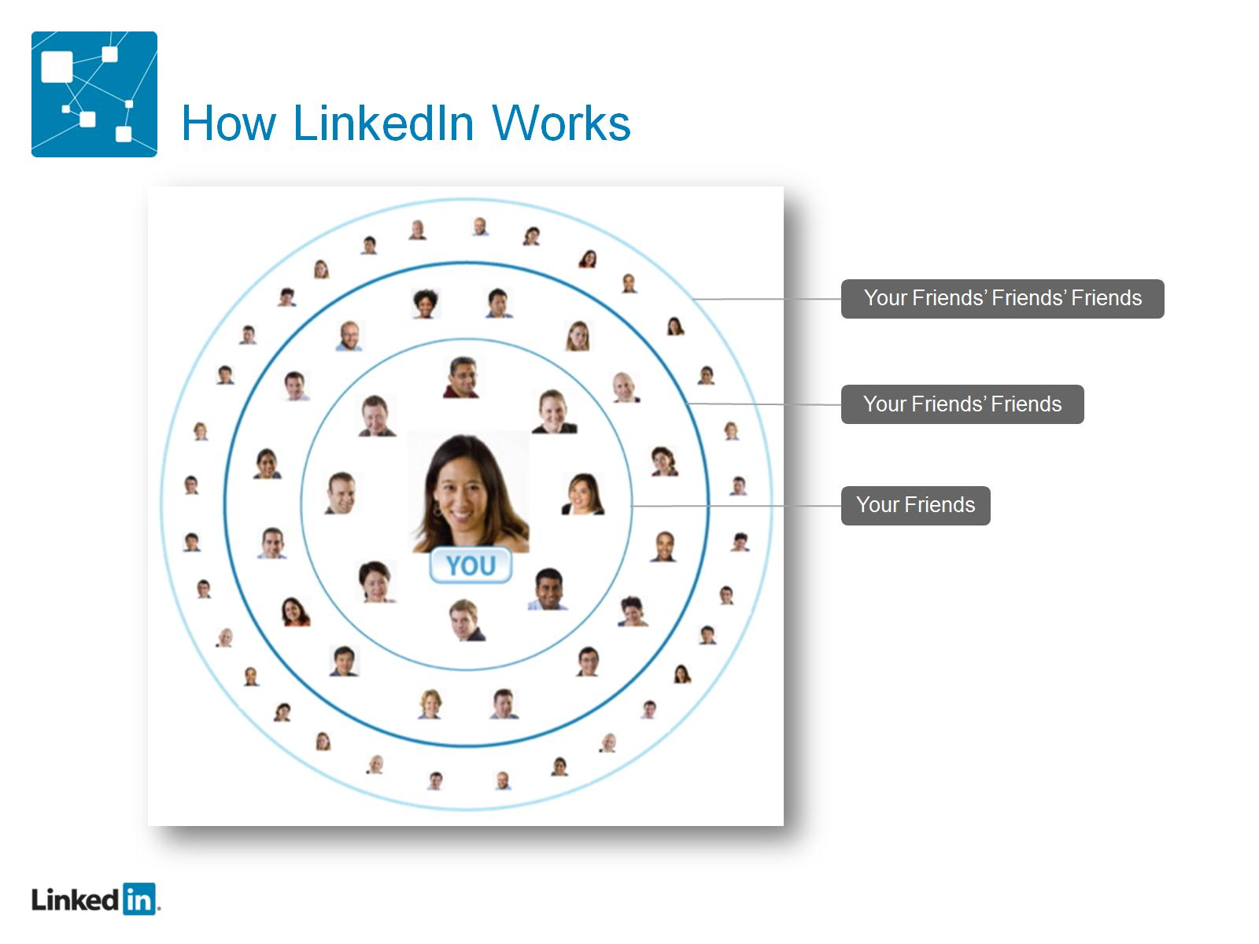
How LinkedIn Works

Slide 9
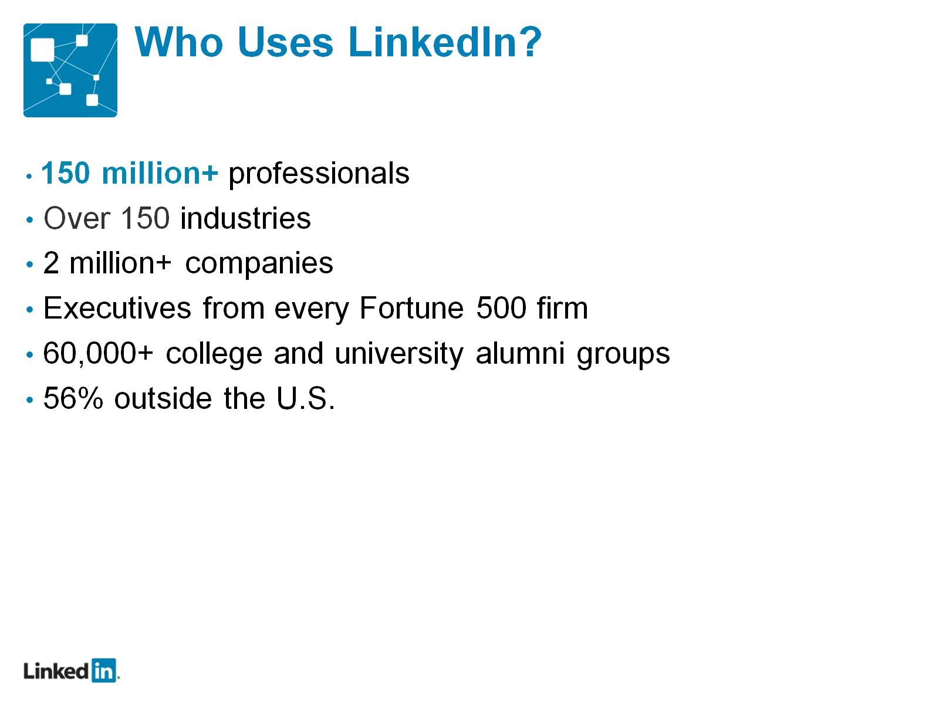
Who Uses LinkedIn?

Slide 10
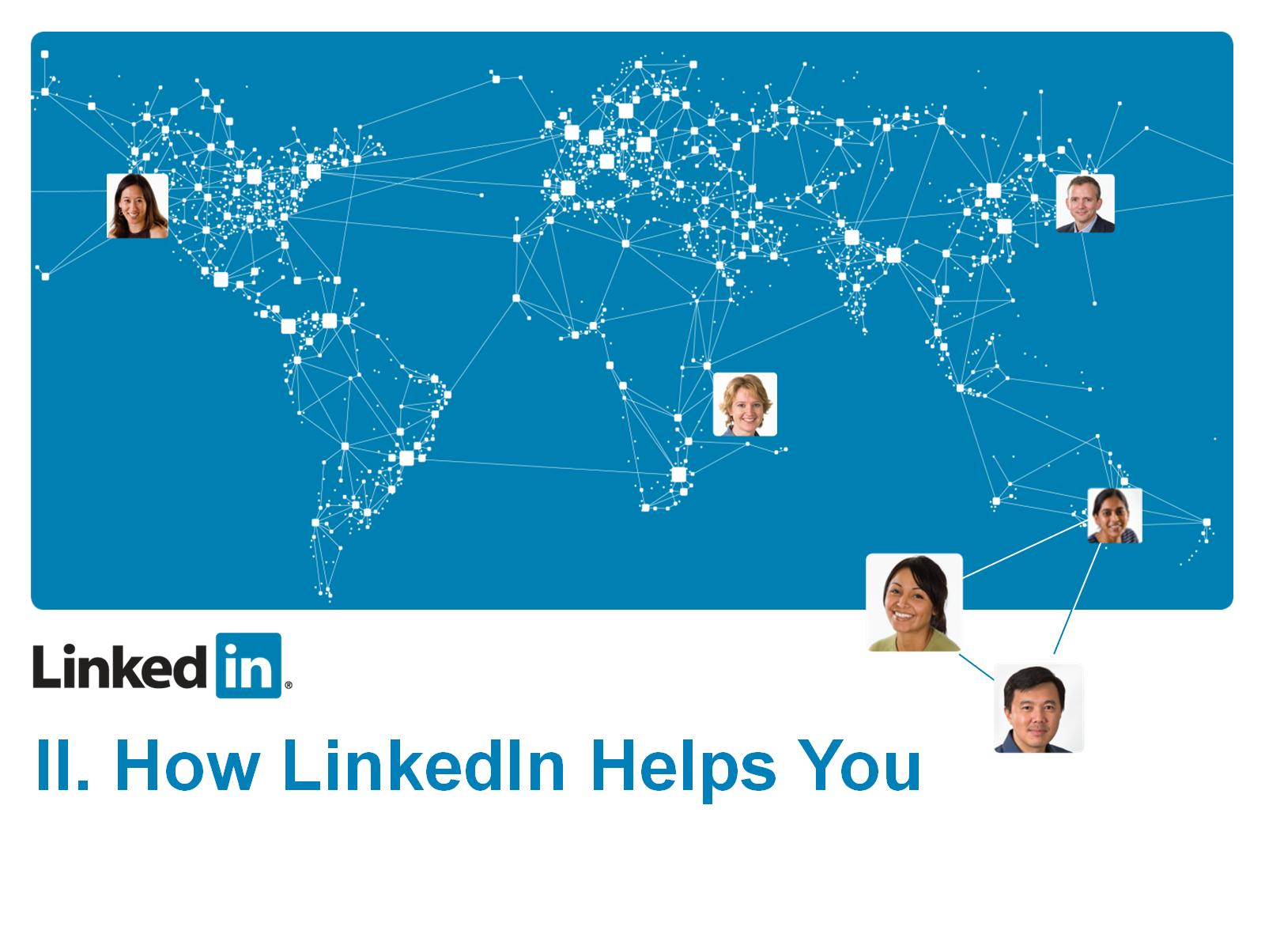

Slide 11
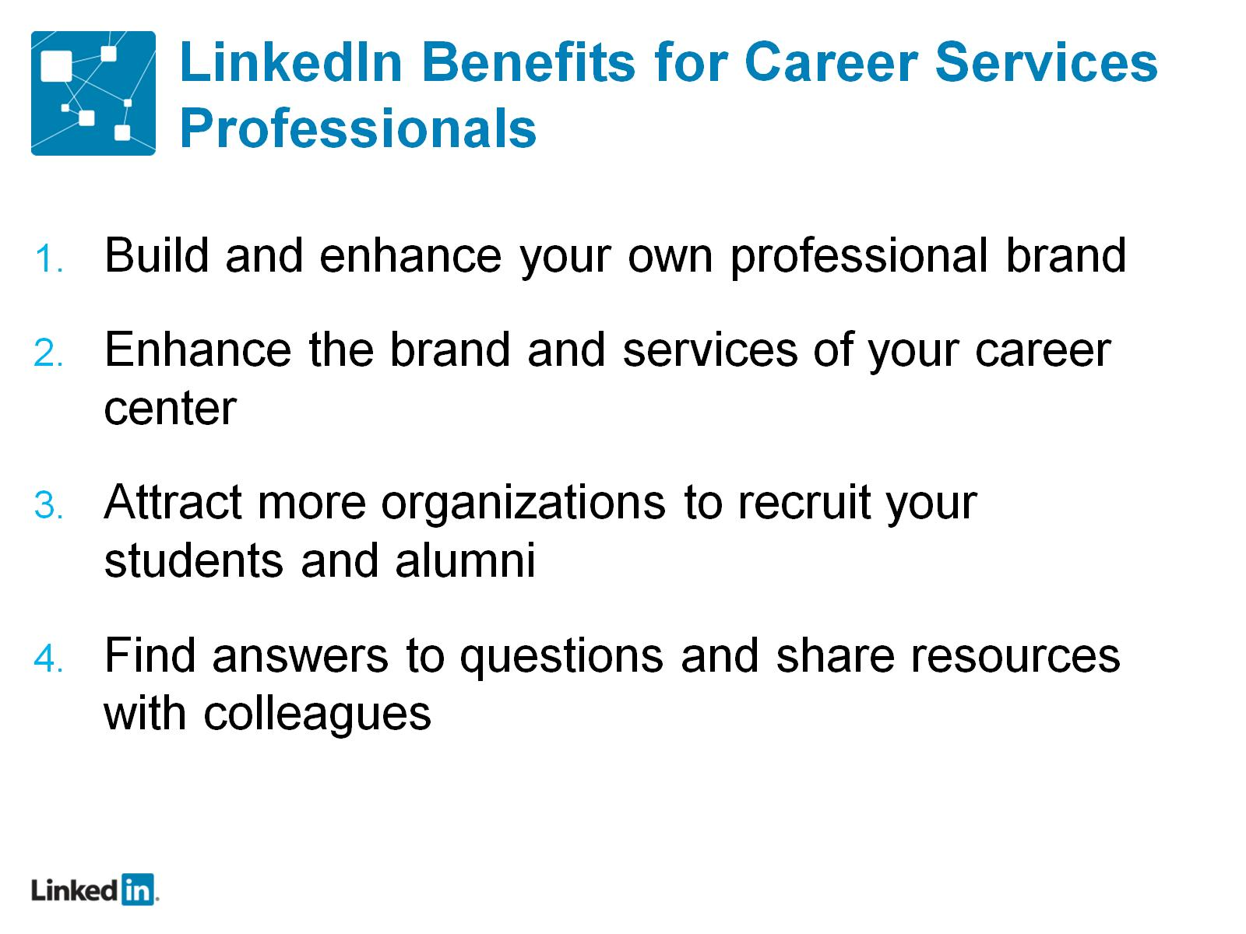
LinkedIn Benefits for Career Services Professionals

Slide 12
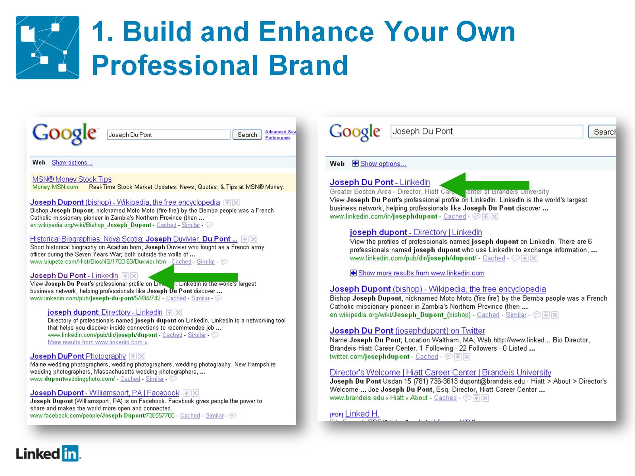
1. 1. Build and Enhance Your Own Professional Brand

Slide 13
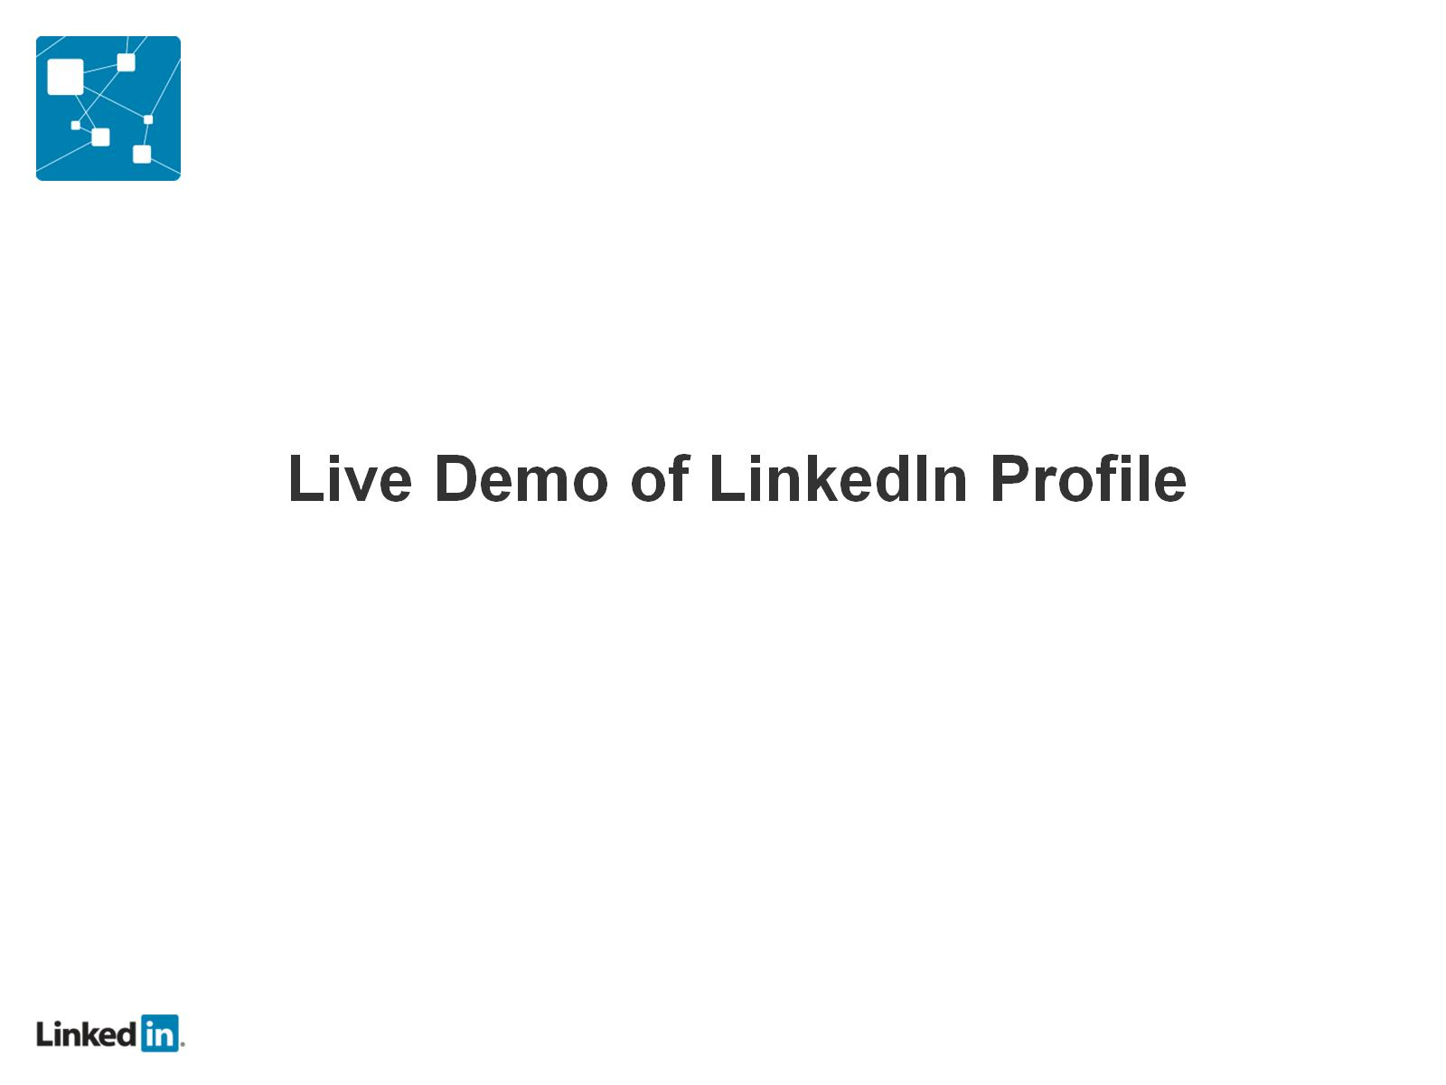

Slide 14
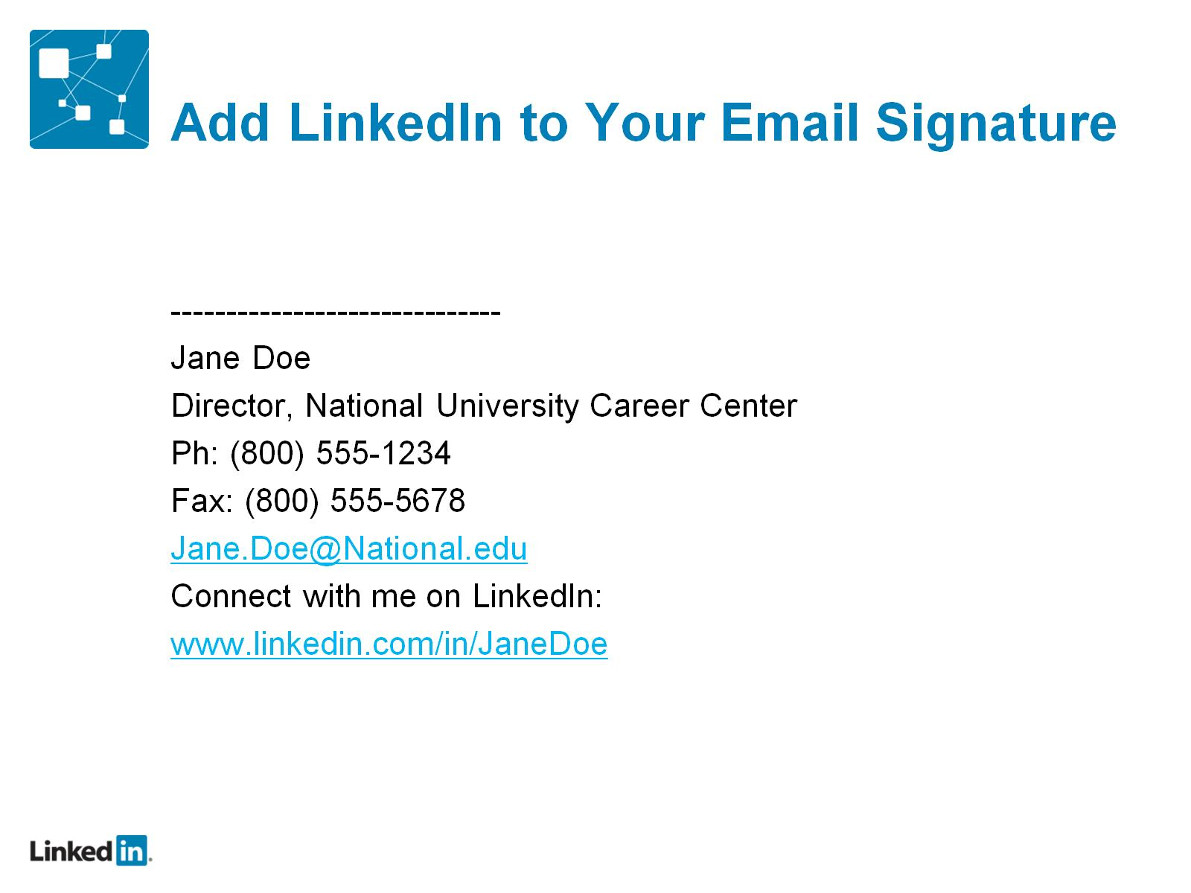
Add LinkedIn to Your Email Signature

Slide 15
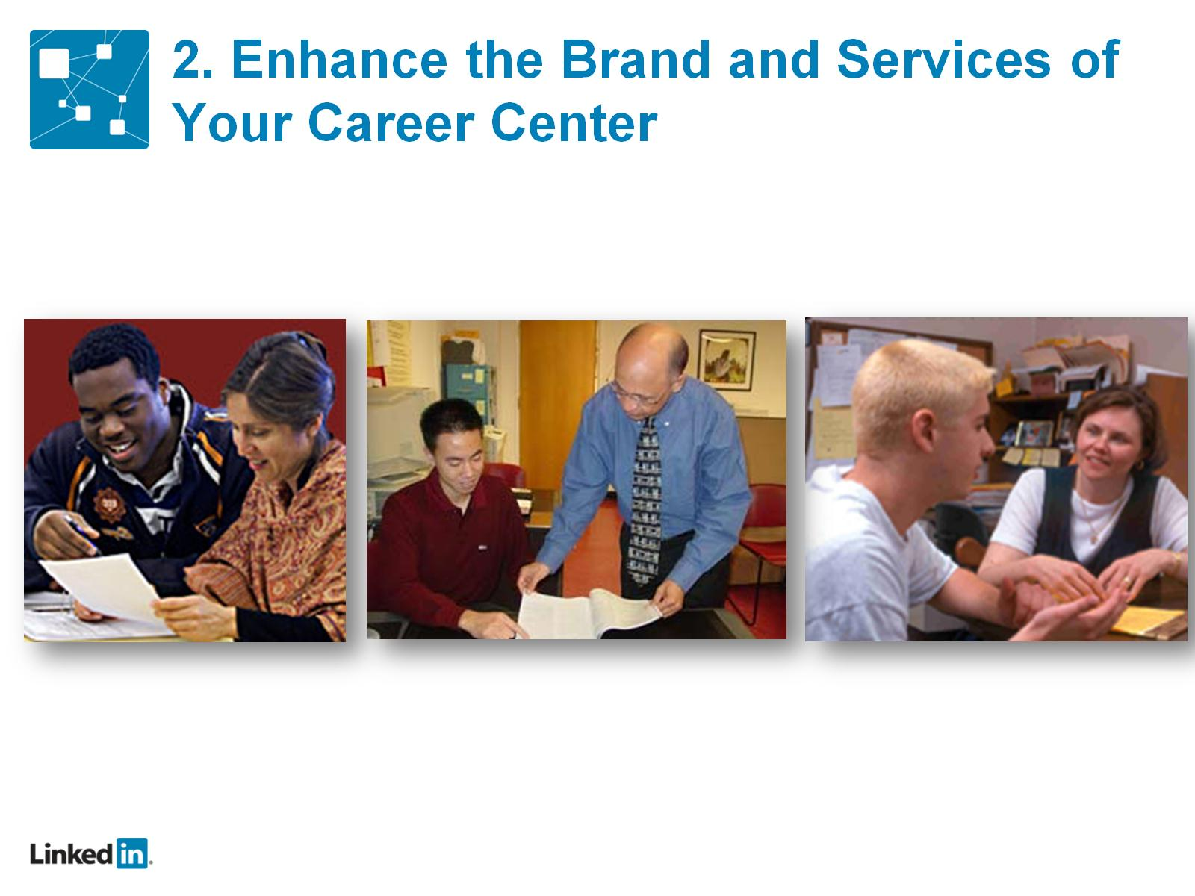
2. Enhance the Brand and Services of Your Career Center

Slide 16
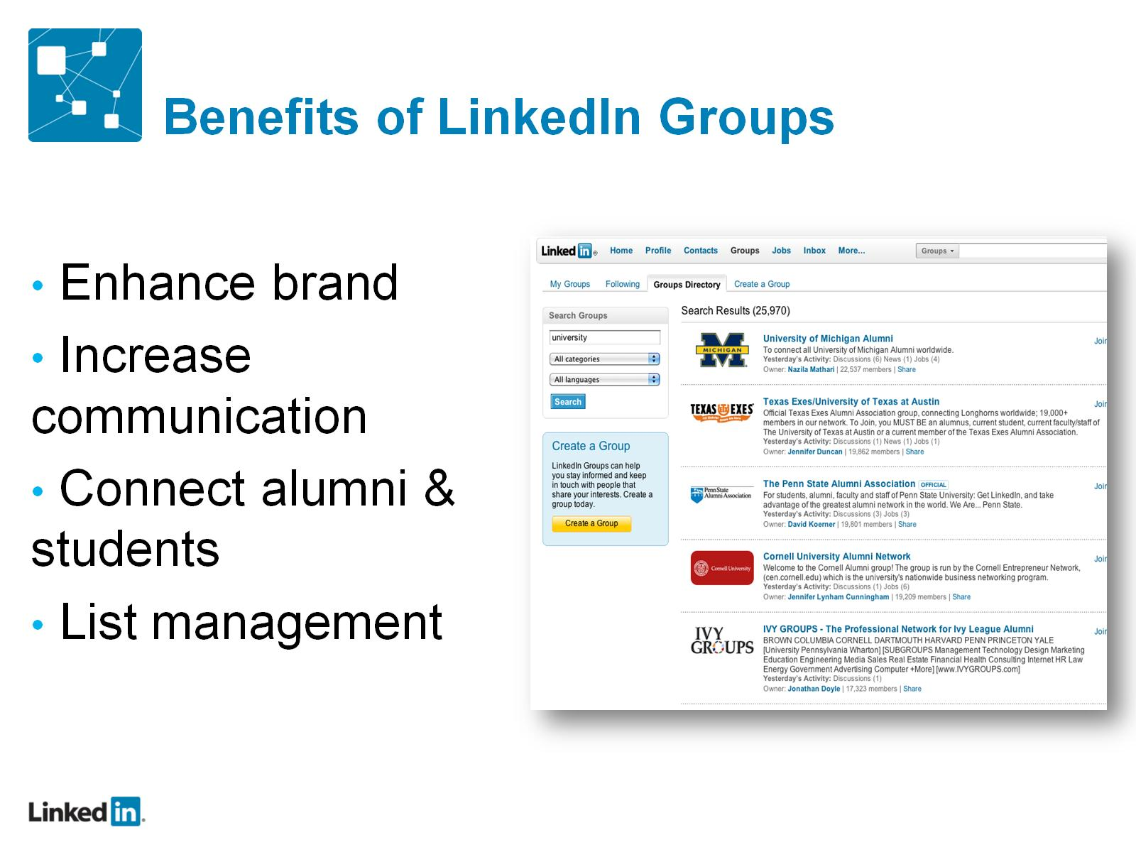
Benefits of LinkedIn Groups

Slide 17


Slide 18
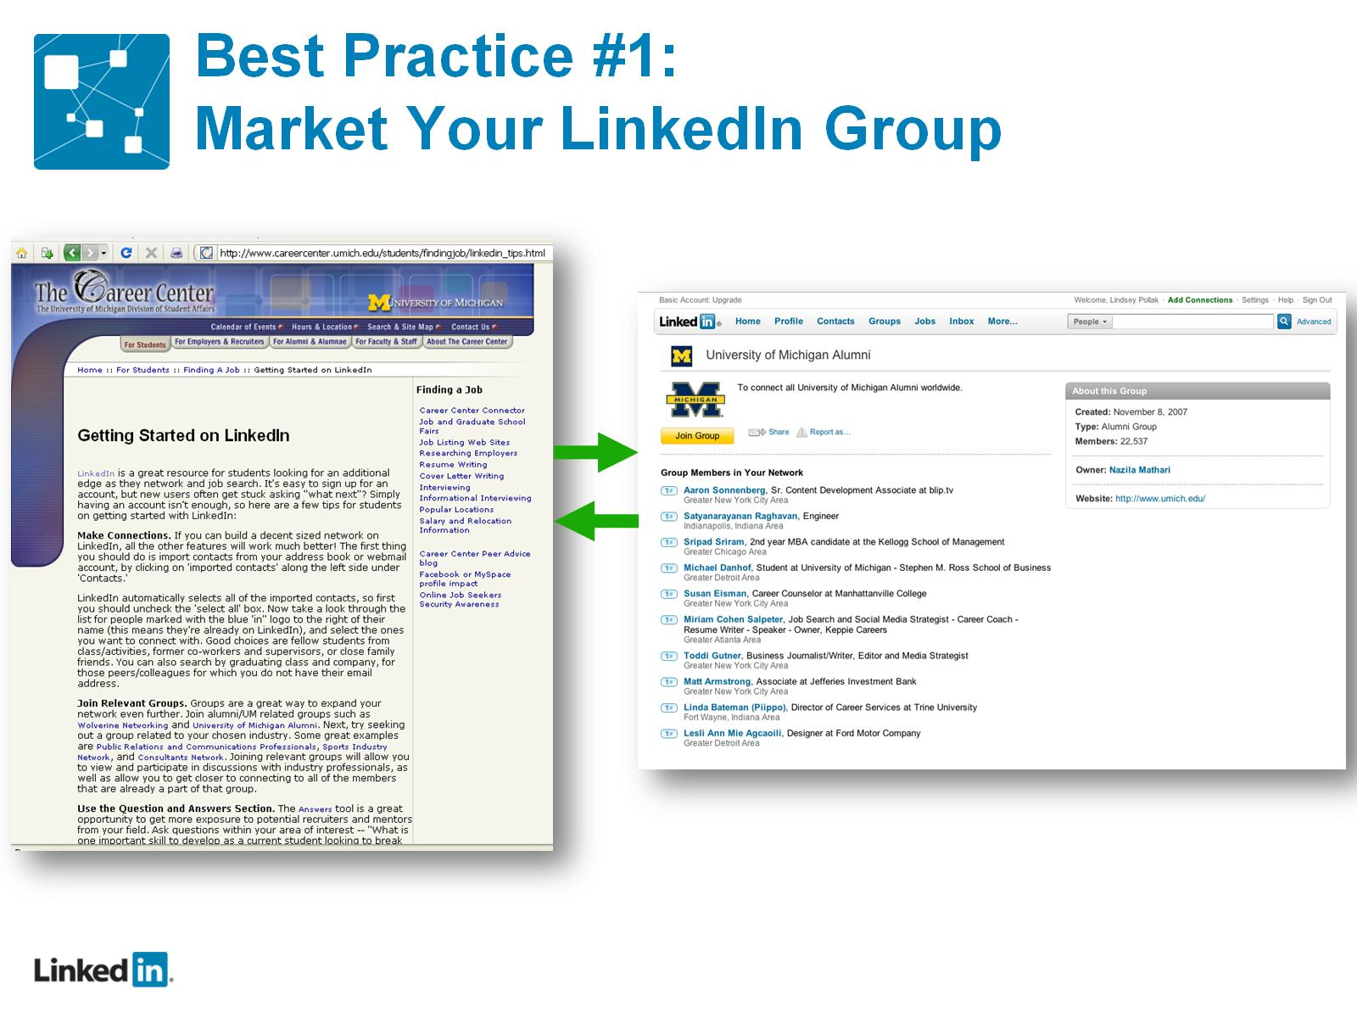
Best Practice #1: Market Your LinkedIn Group

Slide 19
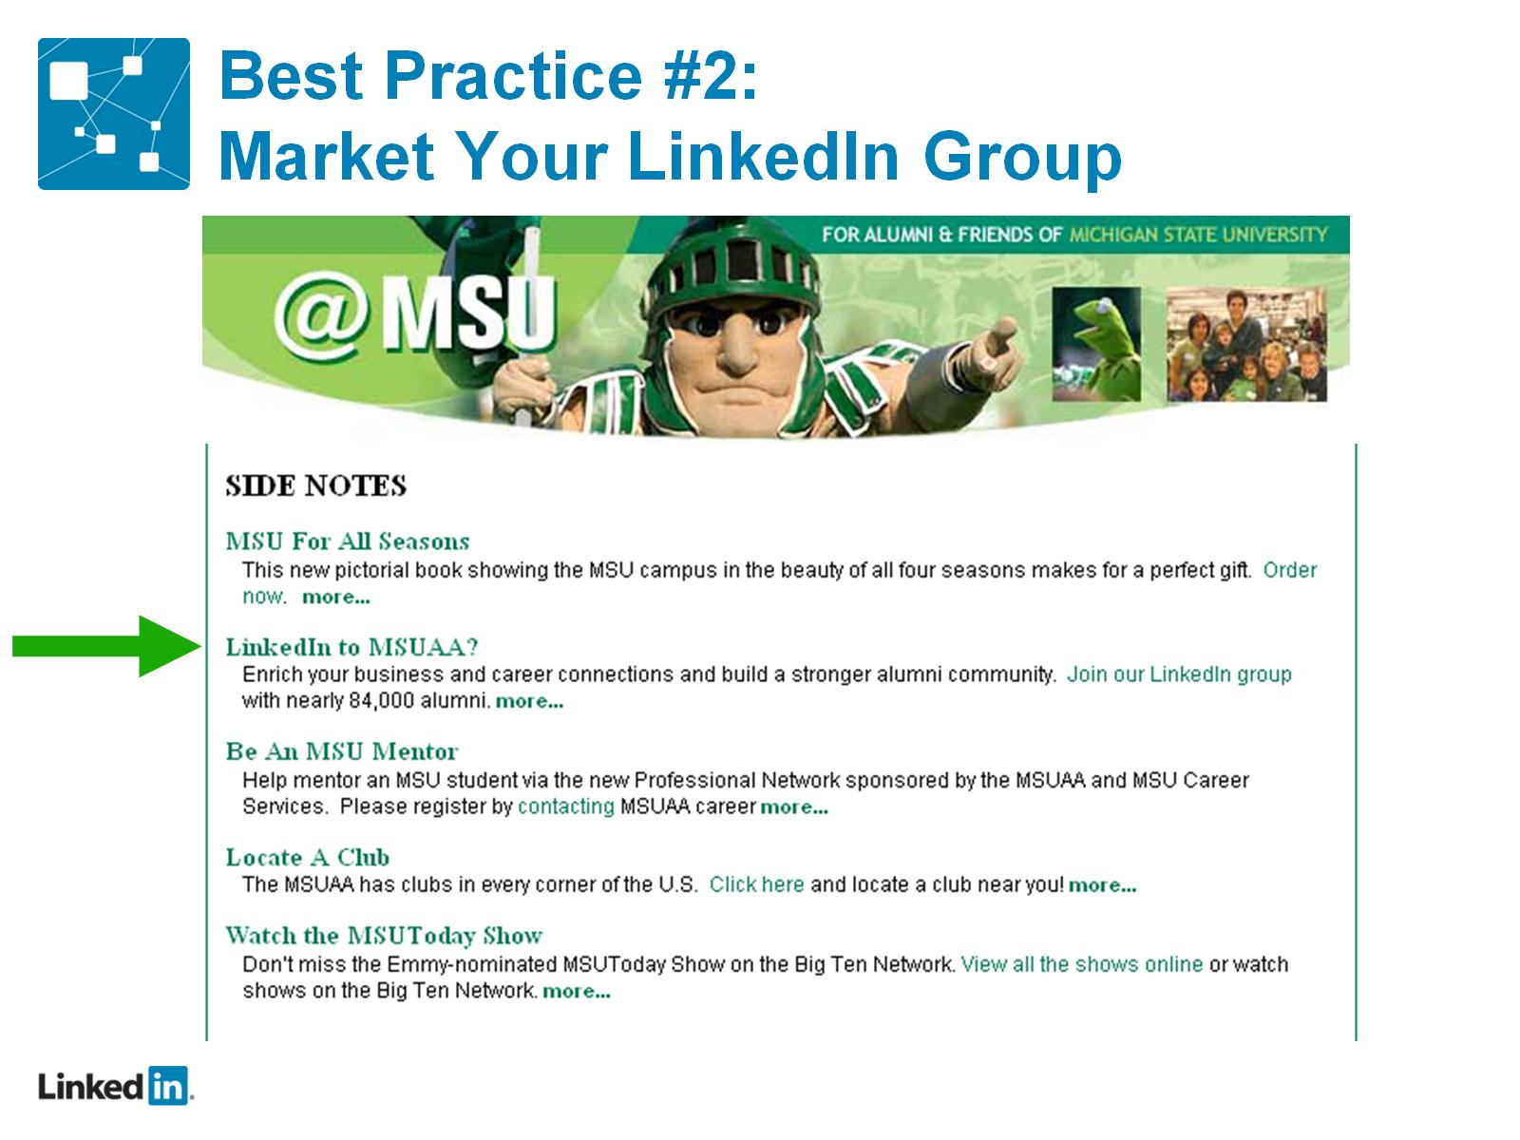
Best Practice #2: Market Your LinkedIn Group

Slide 20
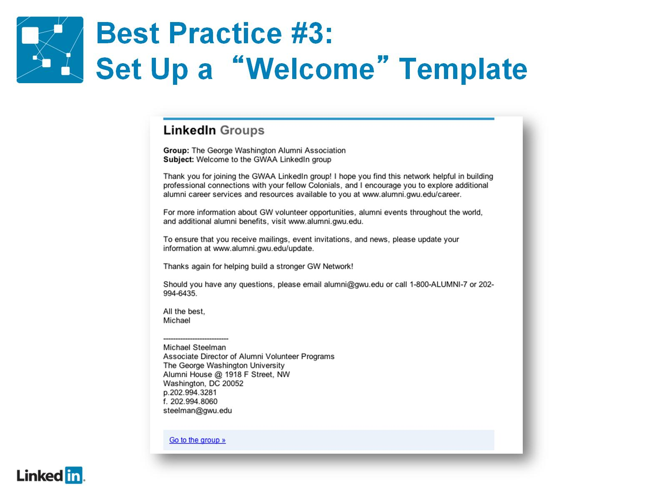
Best Practice #3: Set Up a “Welcome” Template

Slide 21
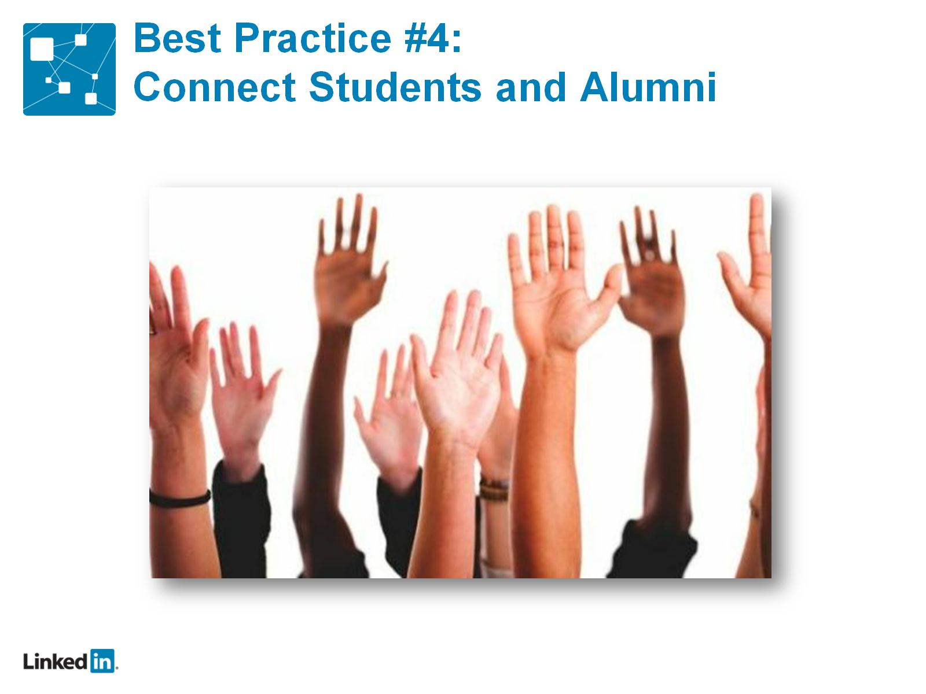
Best Practice #4: Connect Students and Alumni

Slide 22
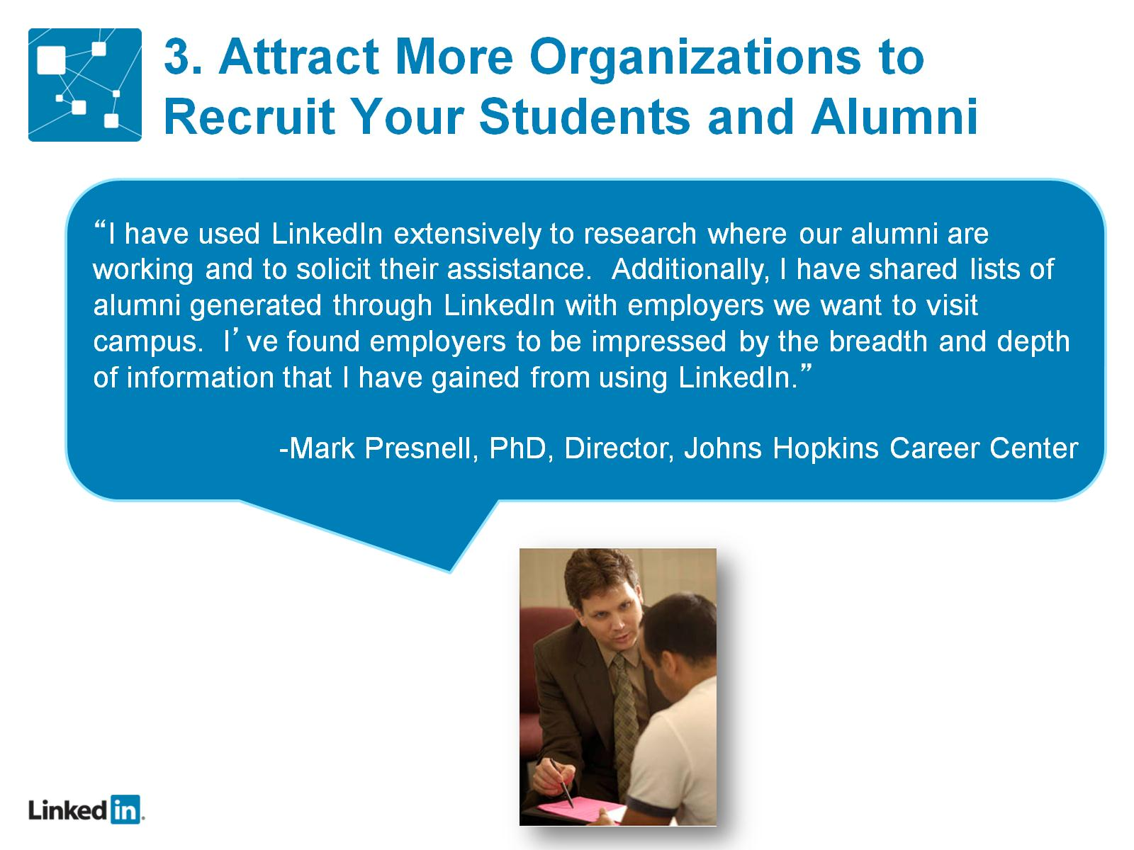
3. Attract More Organizations to Recruit Your Students and Alumni

Slide 23
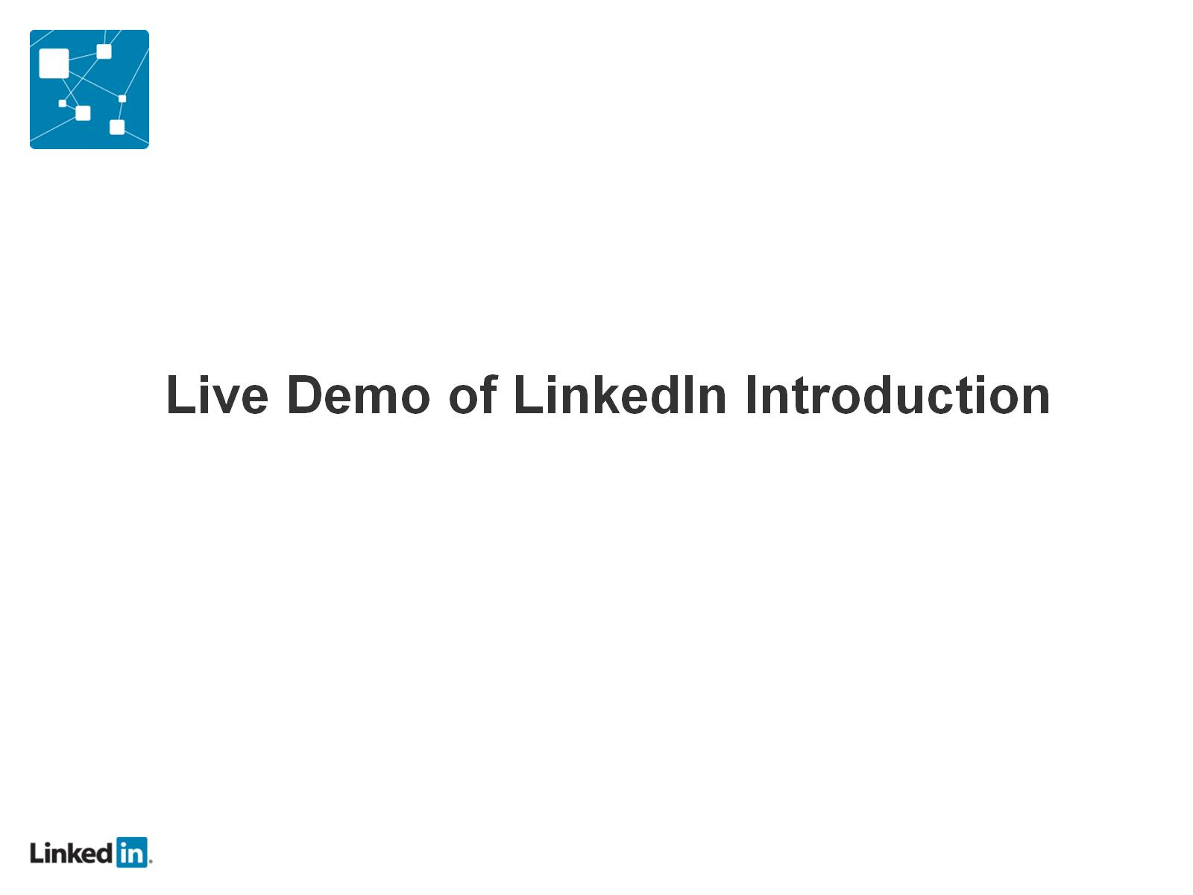

Slide 24
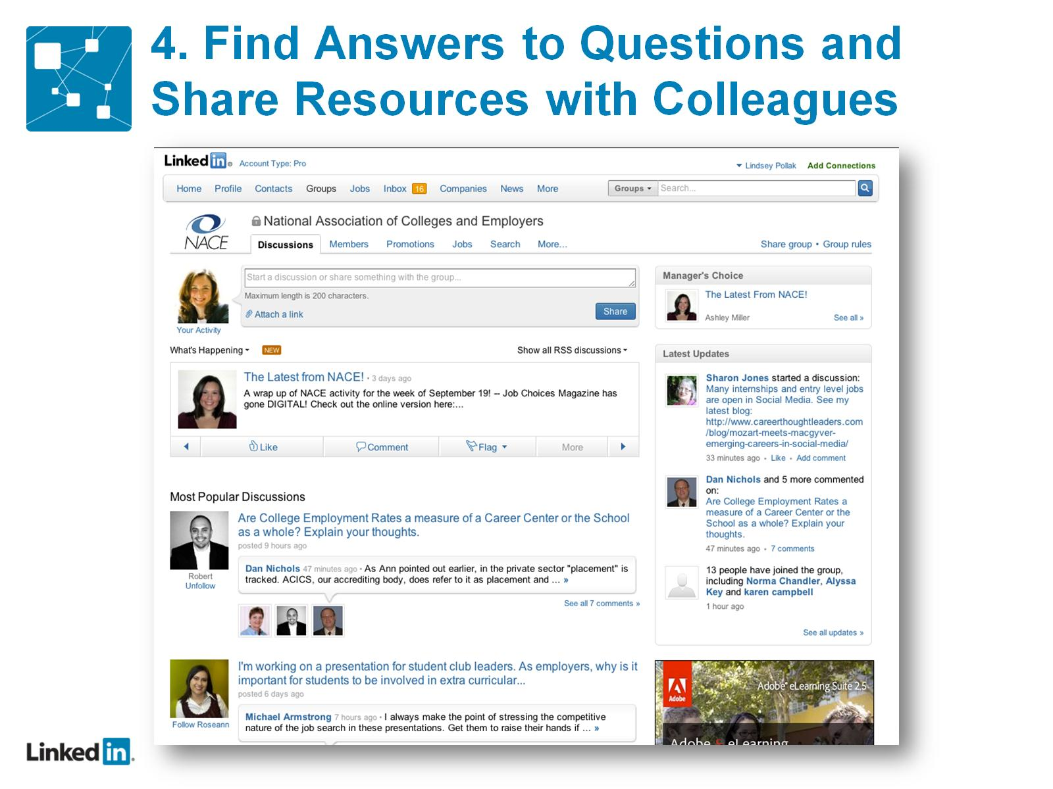
4. Find Answers to Questions and Share Resources with Colleagues

Slide 25
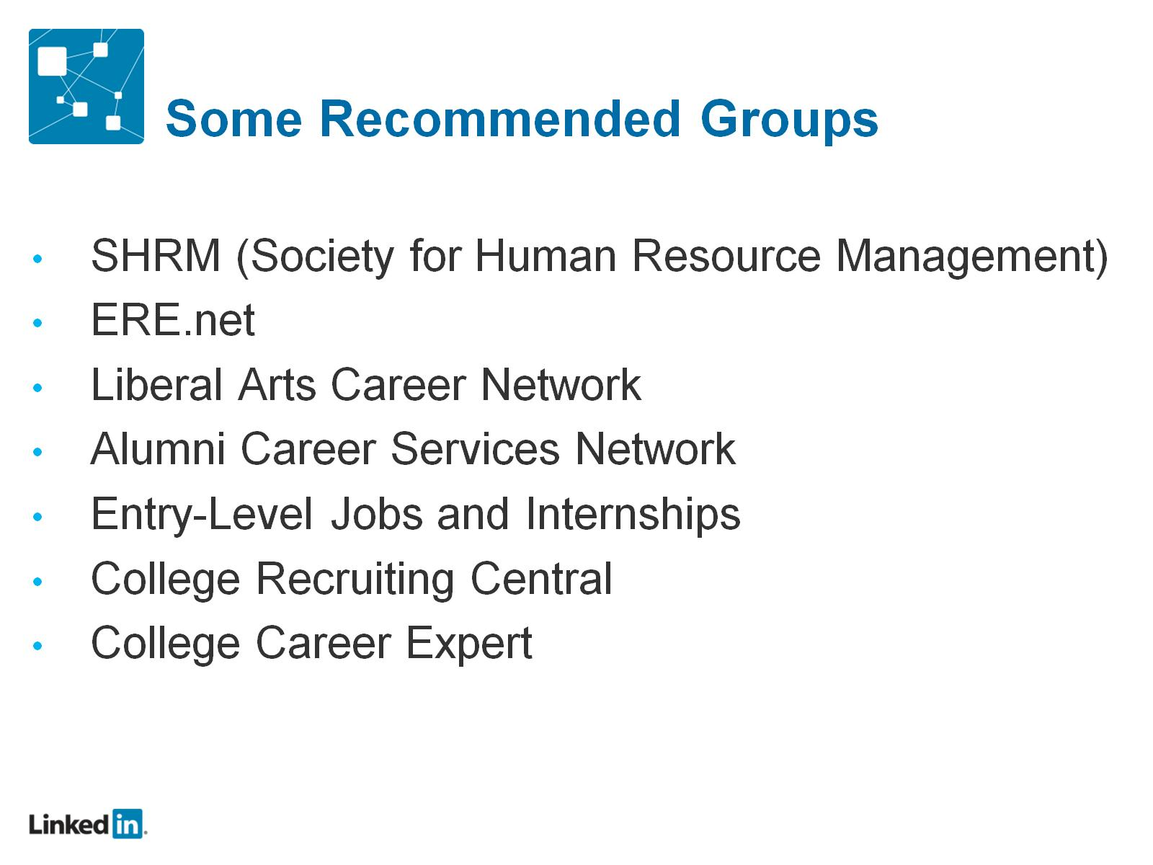
Some Recommended Groups

Slide 26
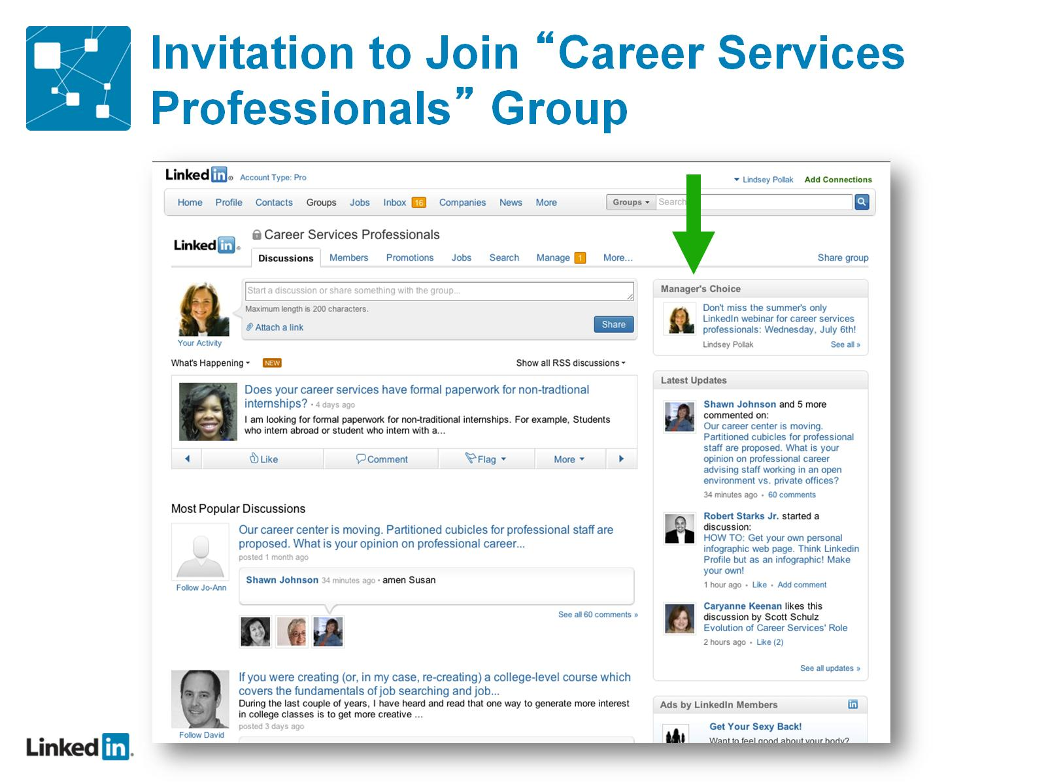
Invitation to Join “Career Services Professionals” Group

Slide 27
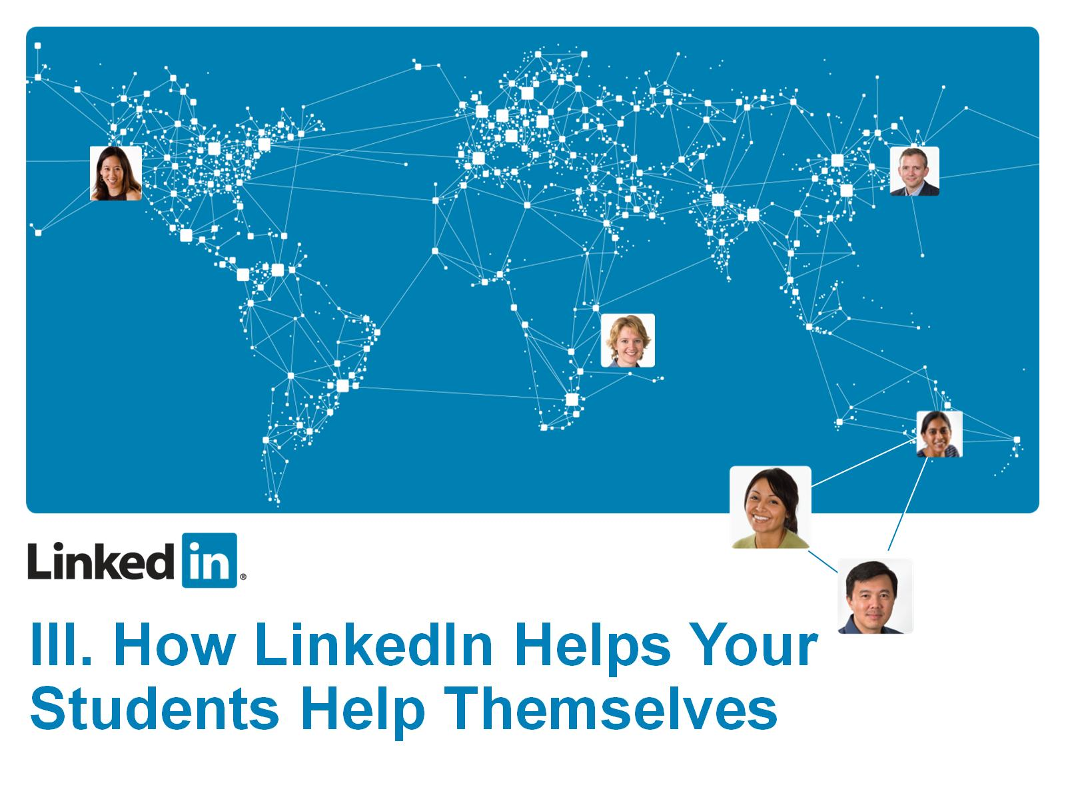

Slide 28
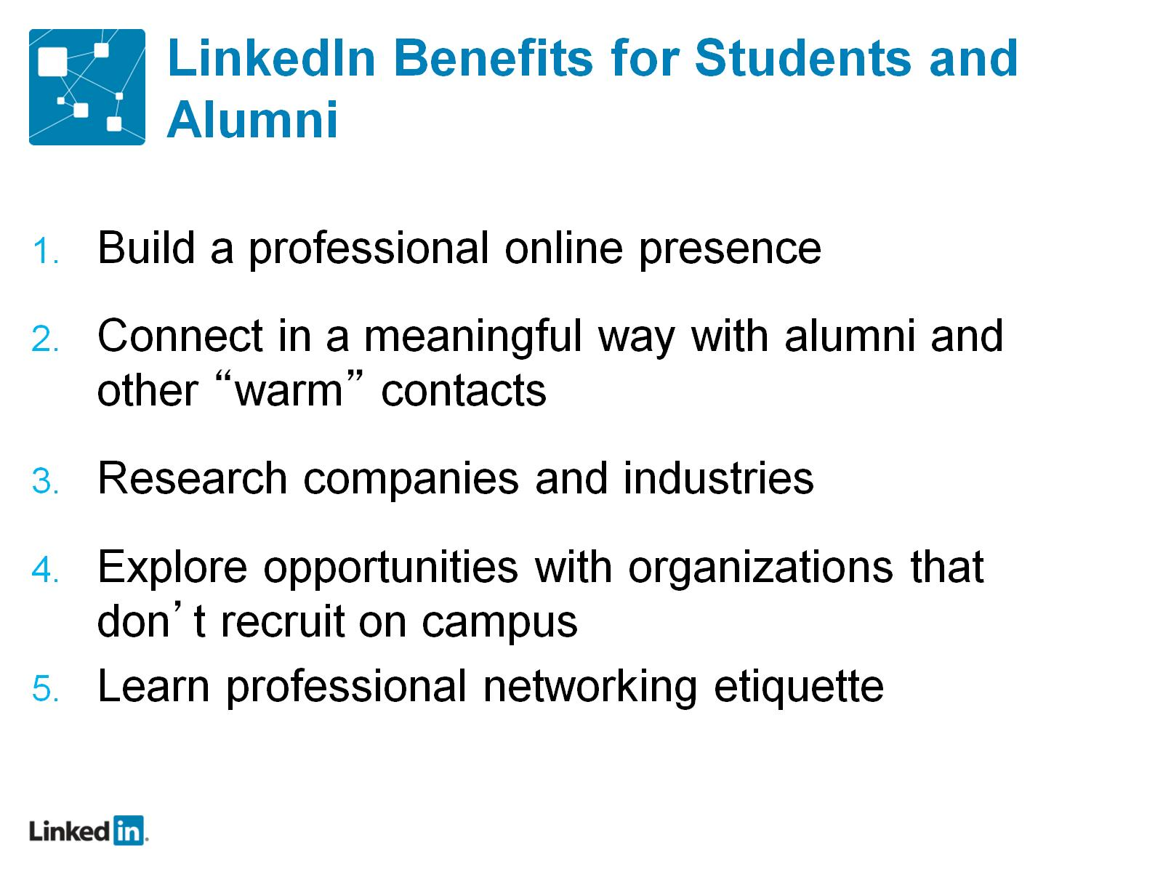
LinkedIn Benefits for Students and Alumni

Slide 29
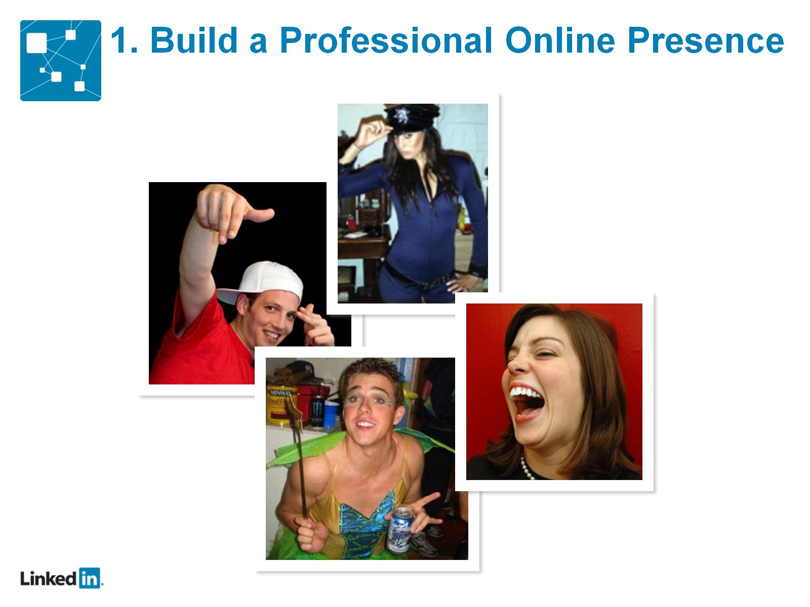

Slide 30
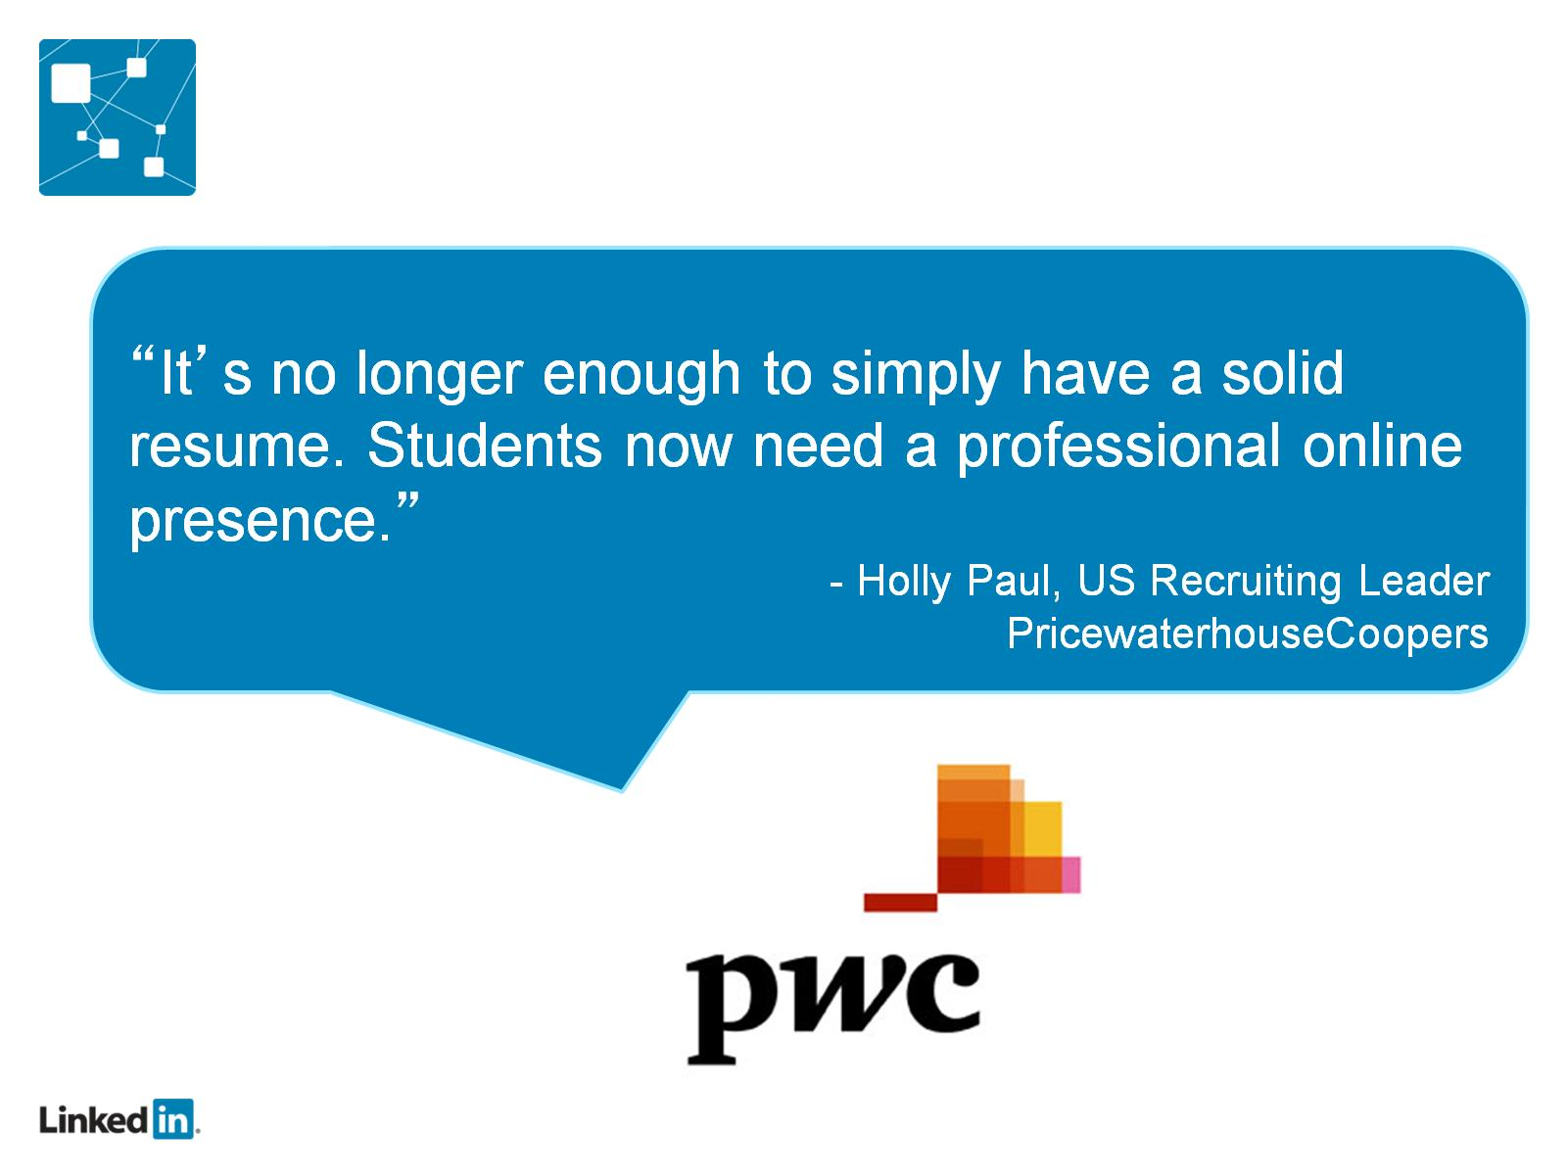

Slide 31
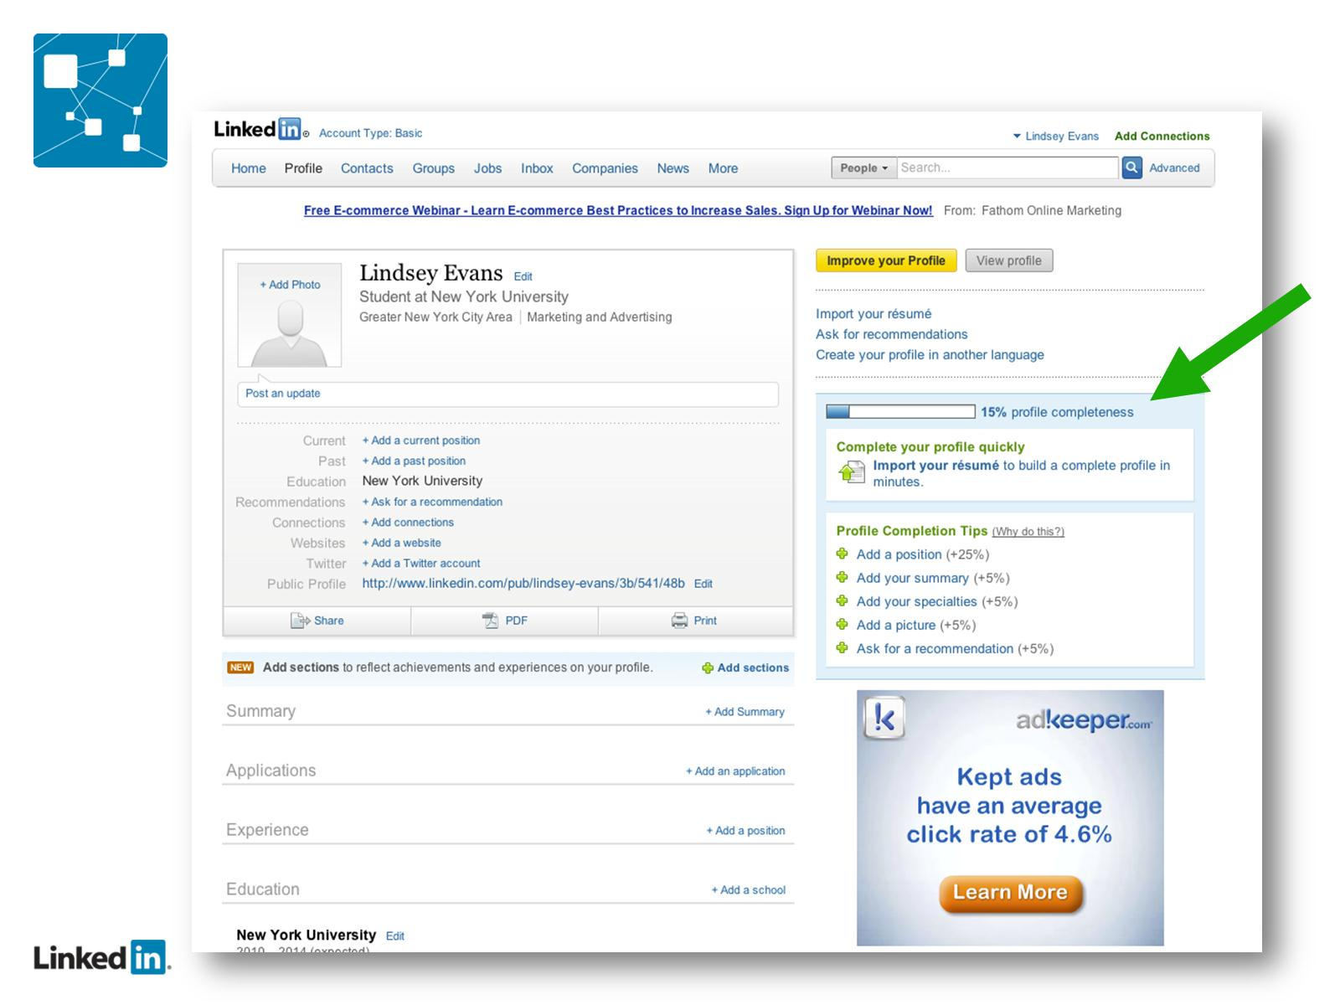

Slide 32
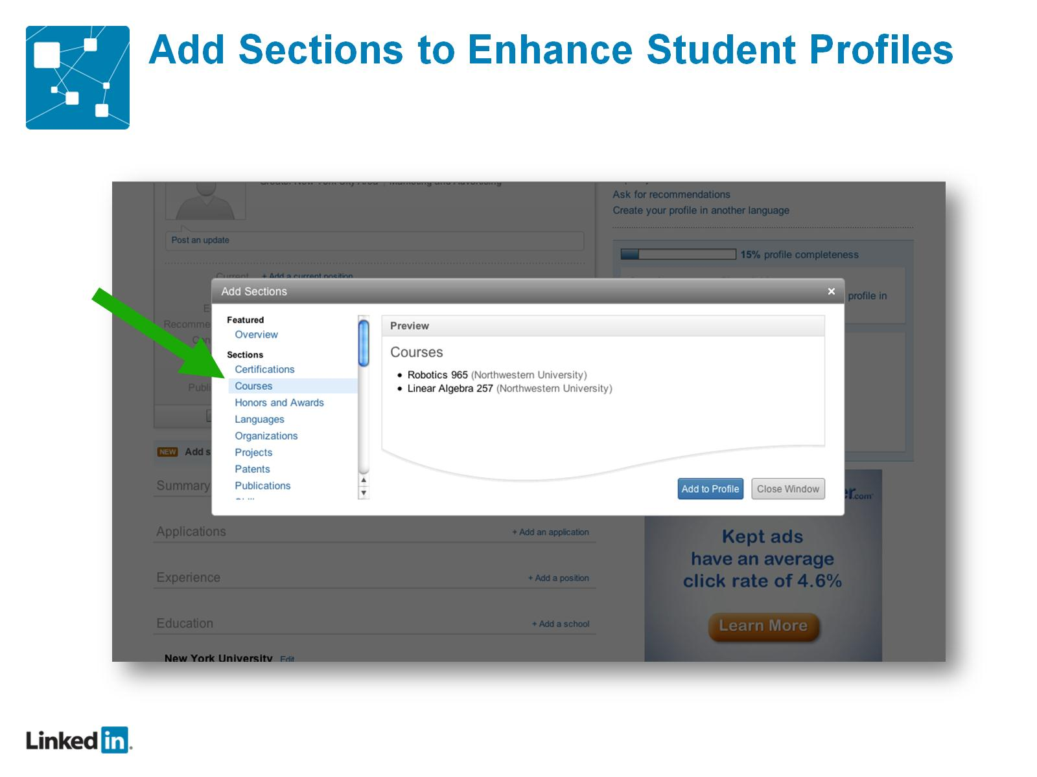
Add Sections to Enhance Student Profiles

Slide 33
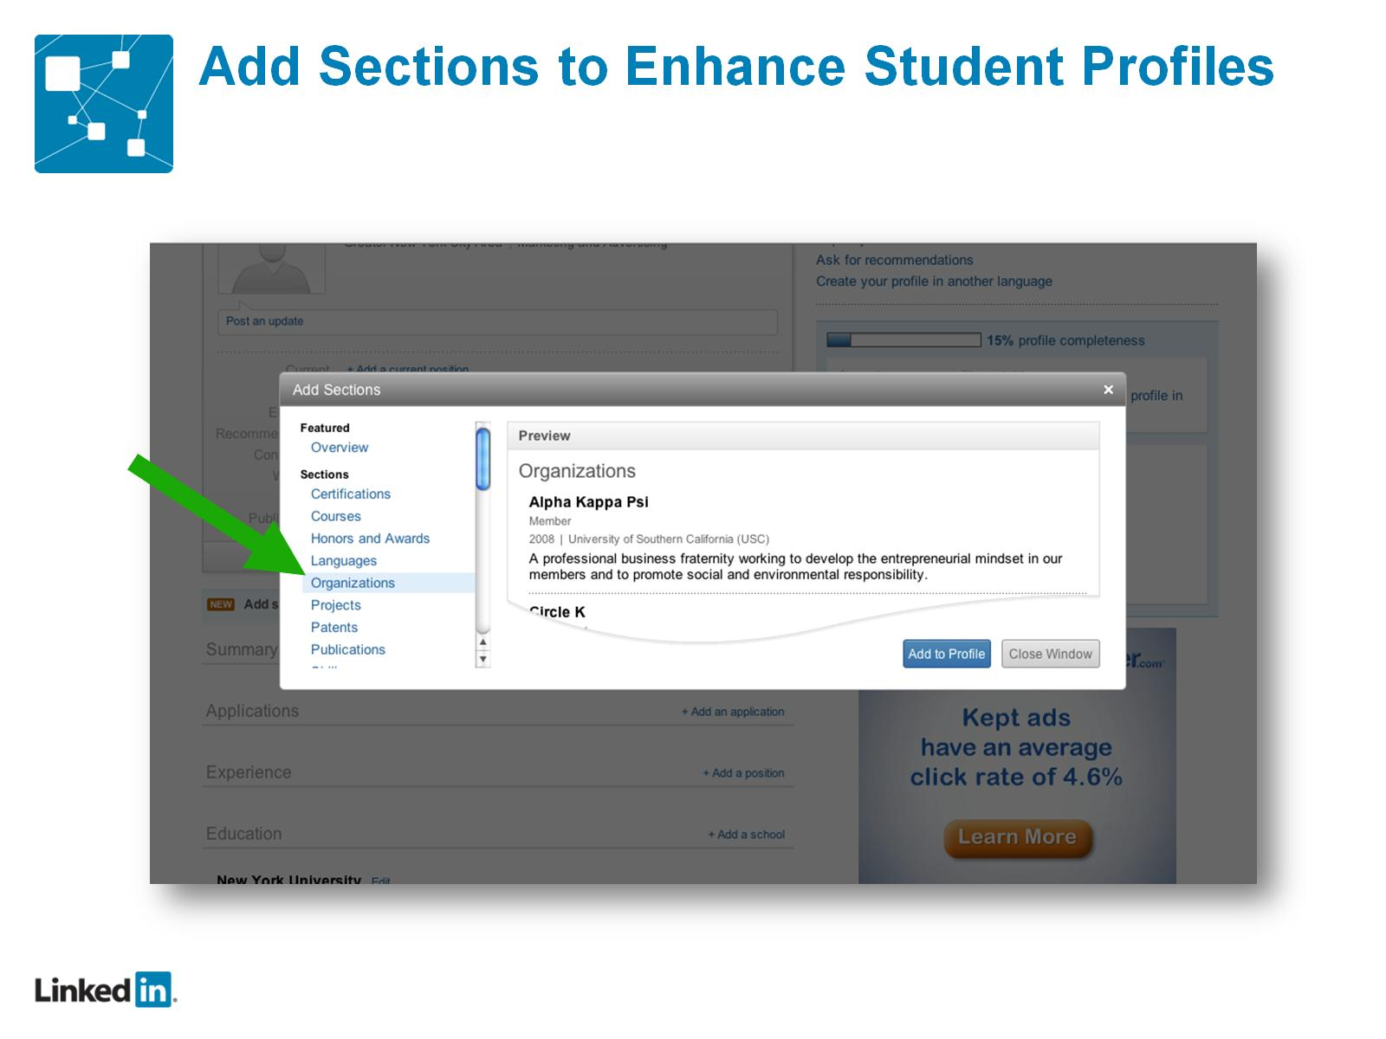
Add Sections to Enhance Student Profiles

Slide 34
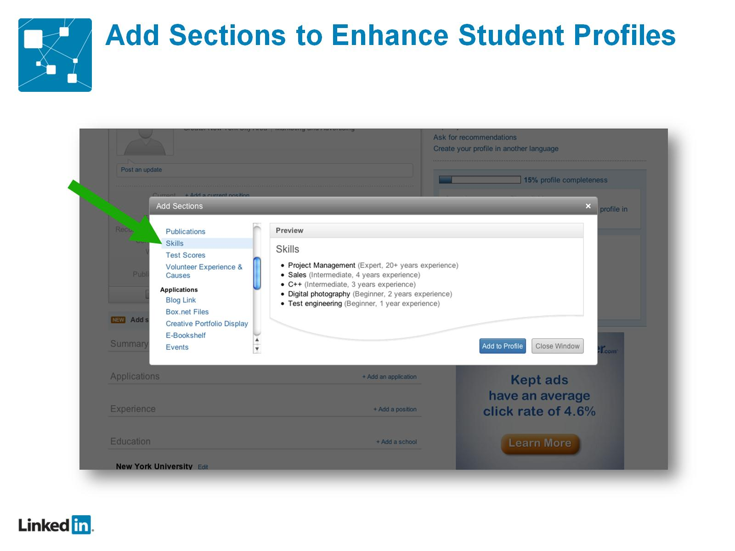
Add Sections to Enhance Student Profiles

Slide 35
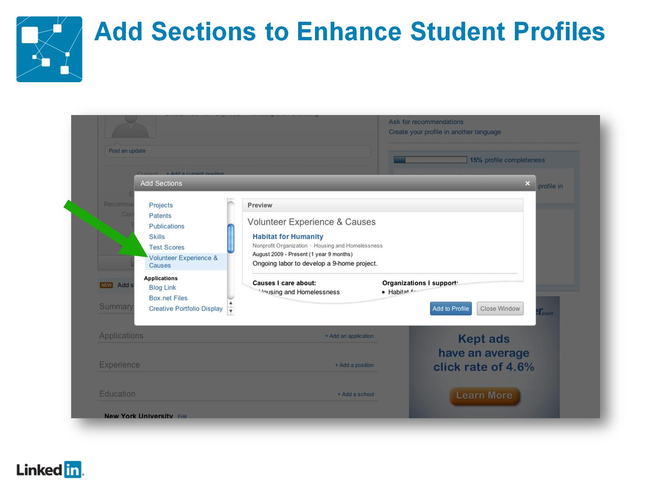
Add Sections to Enhance Student Profiles

Slide 36
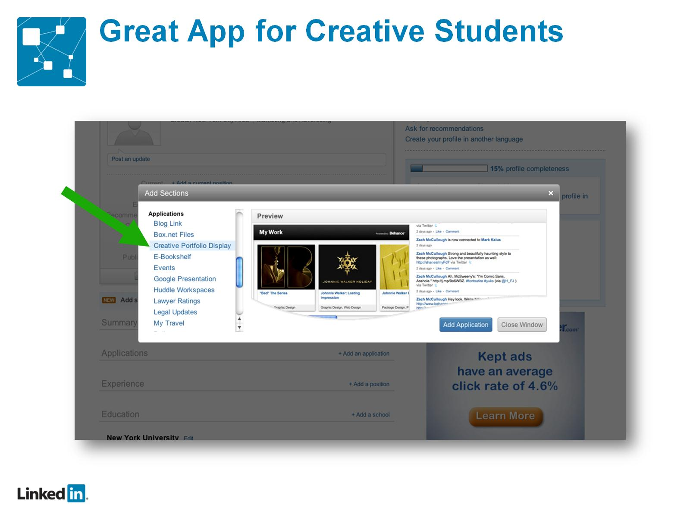
Great App for Creative Students

Slide 37
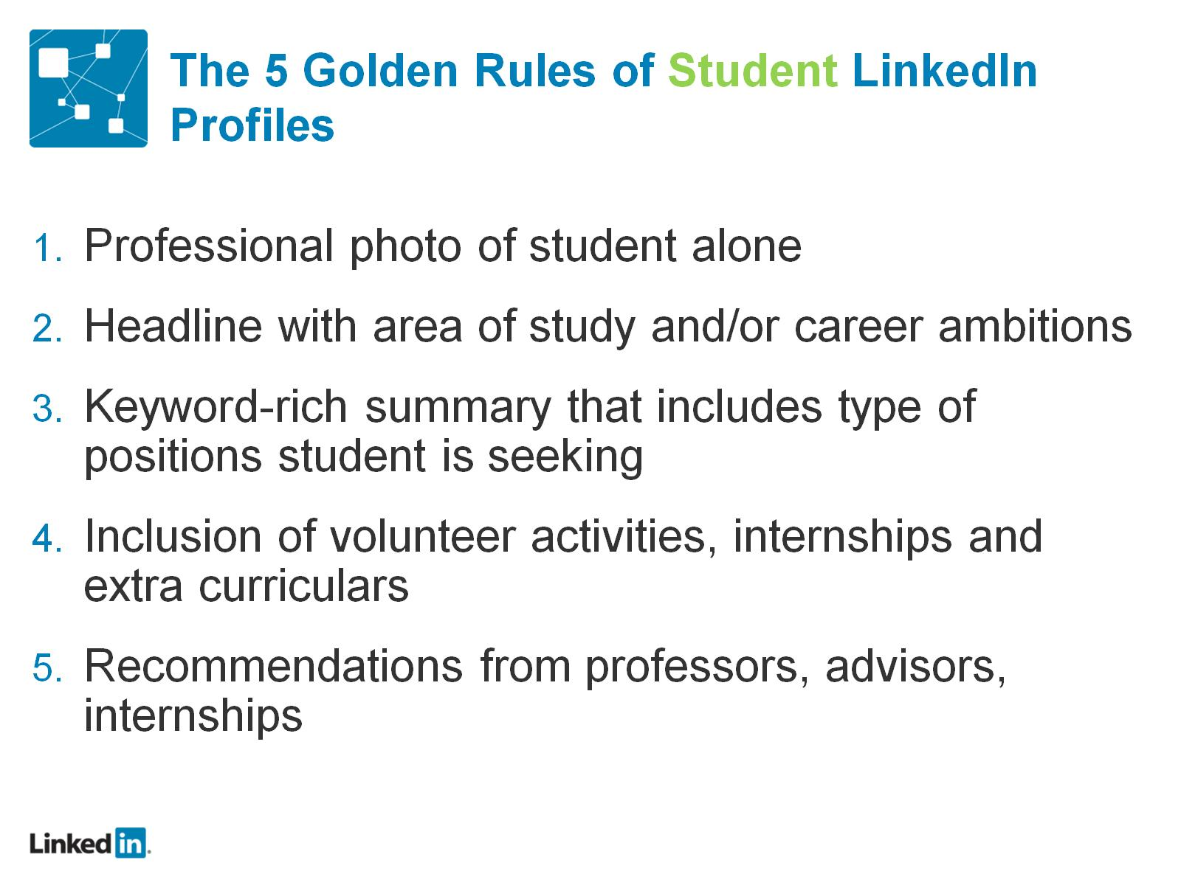
The 5 Golden Rules of Student LinkedIn Profiles

Slide 38
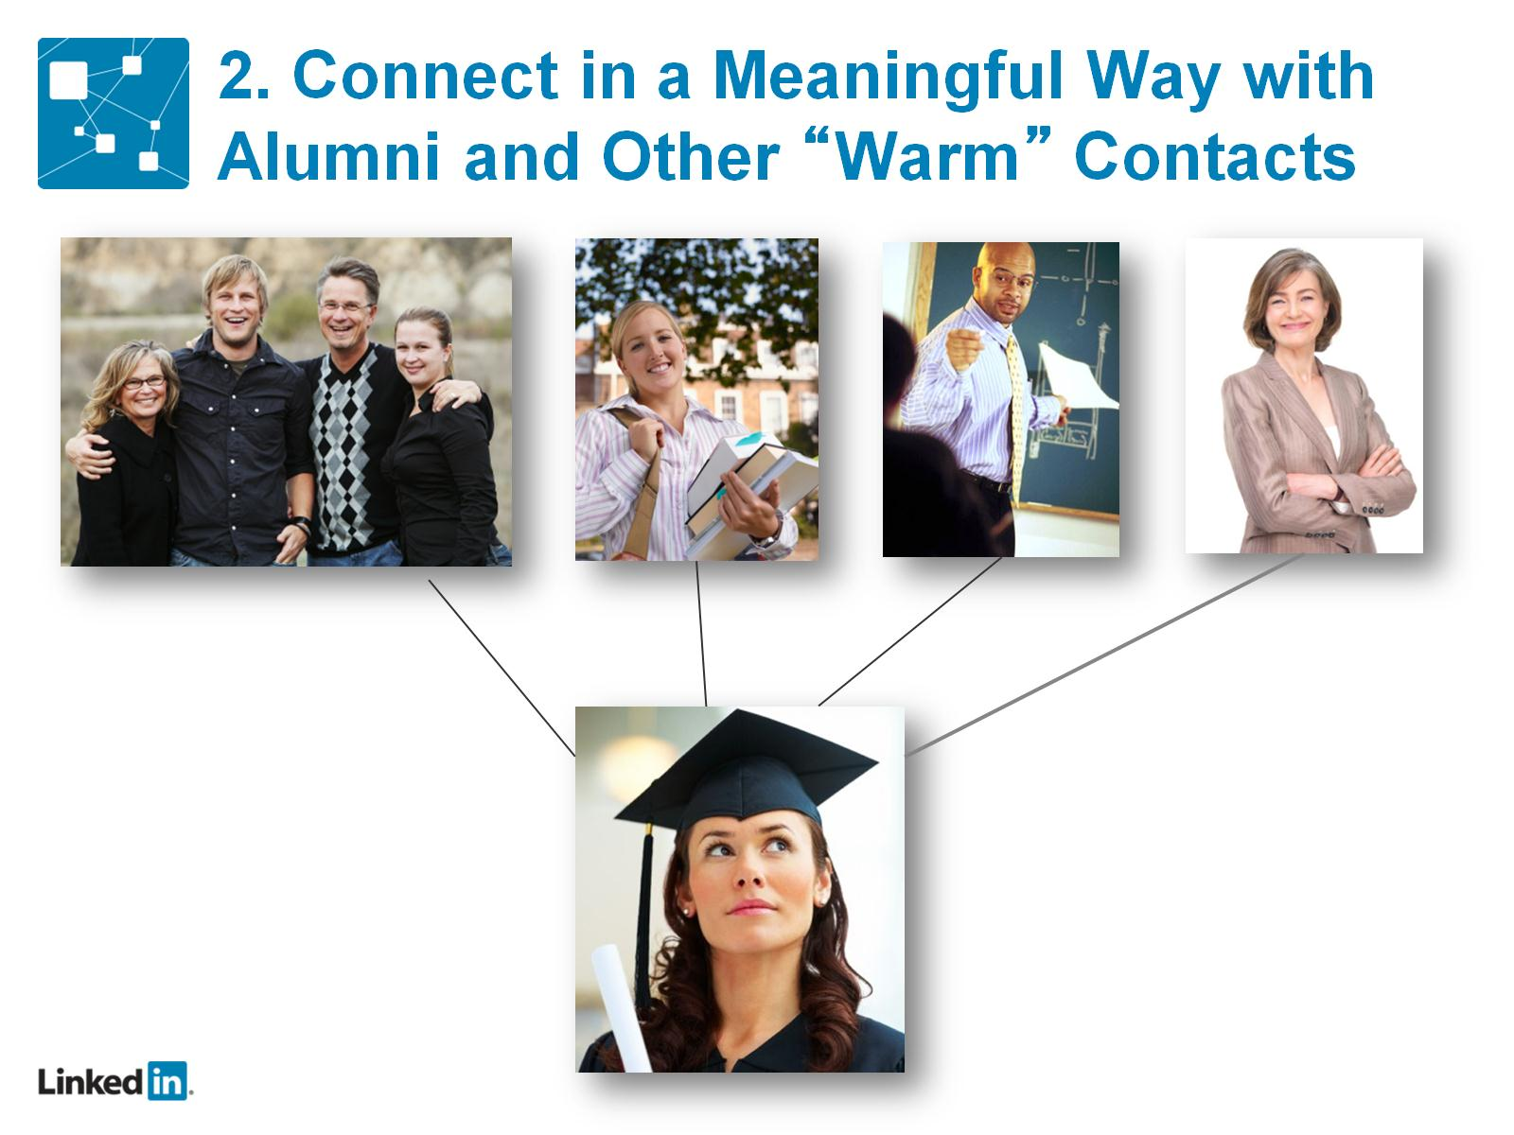
2. Connect in a Meaningful Way with Alumni and Other “Warm” Contacts

Slide 39
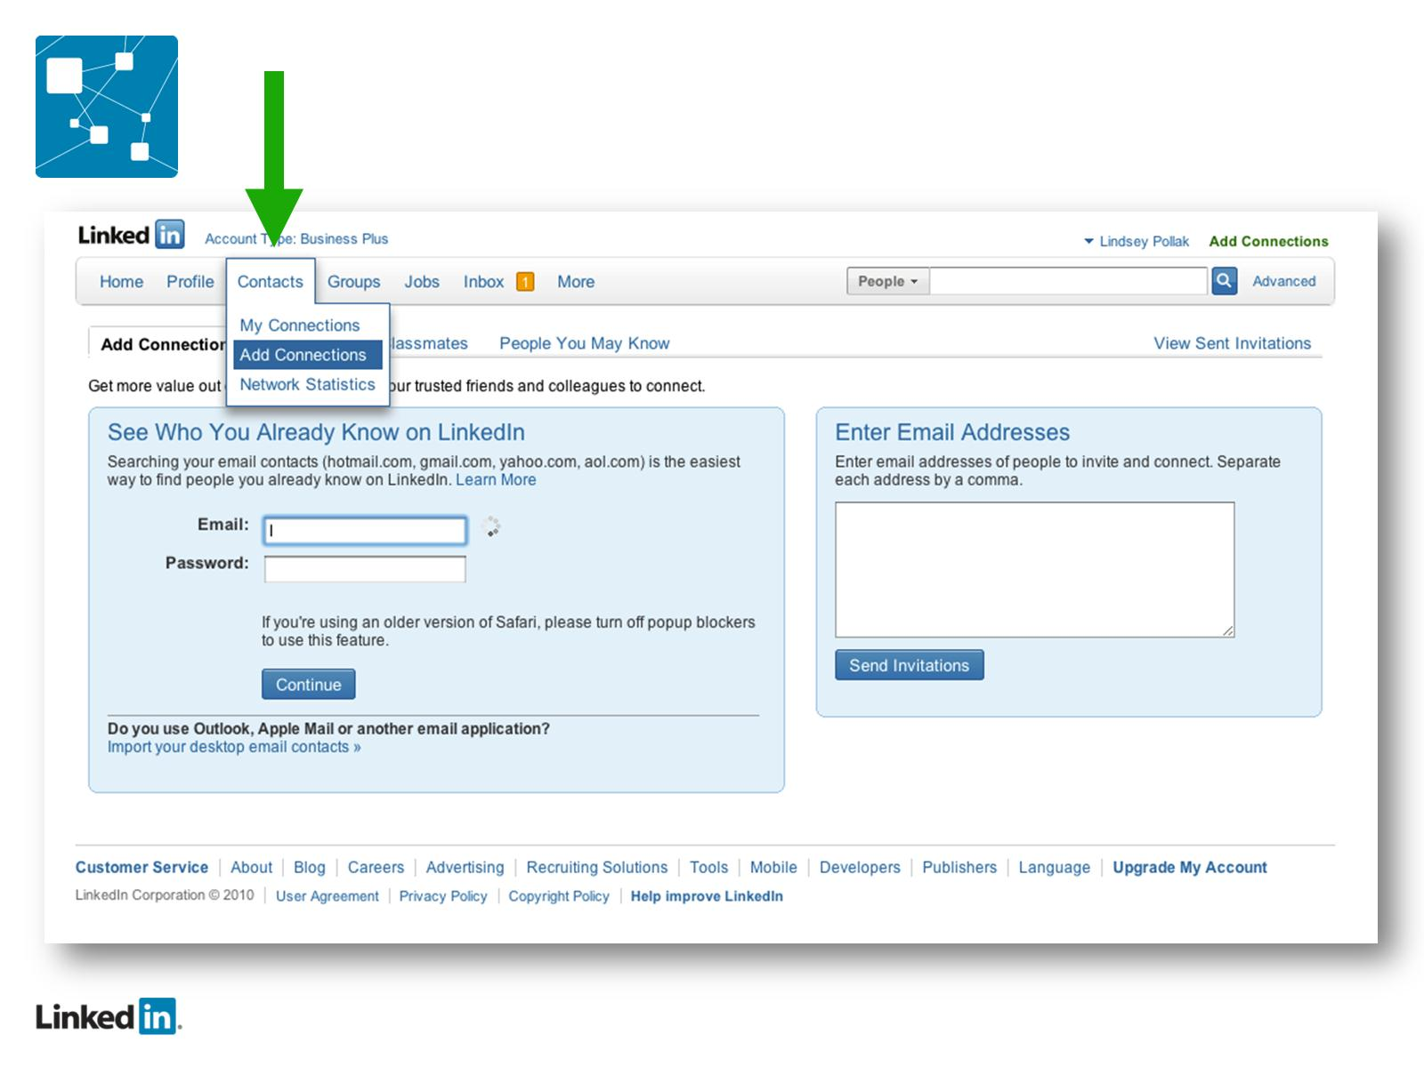

Slide 40
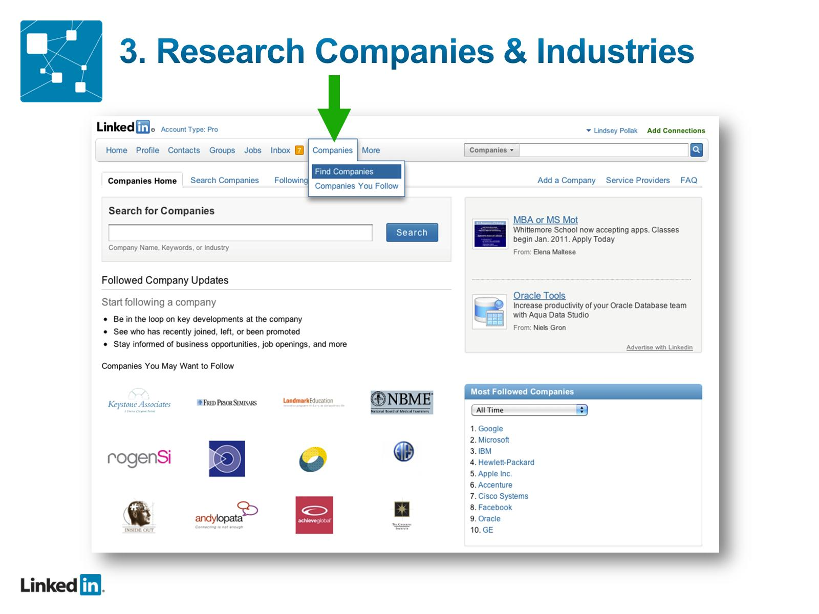

Slide 41
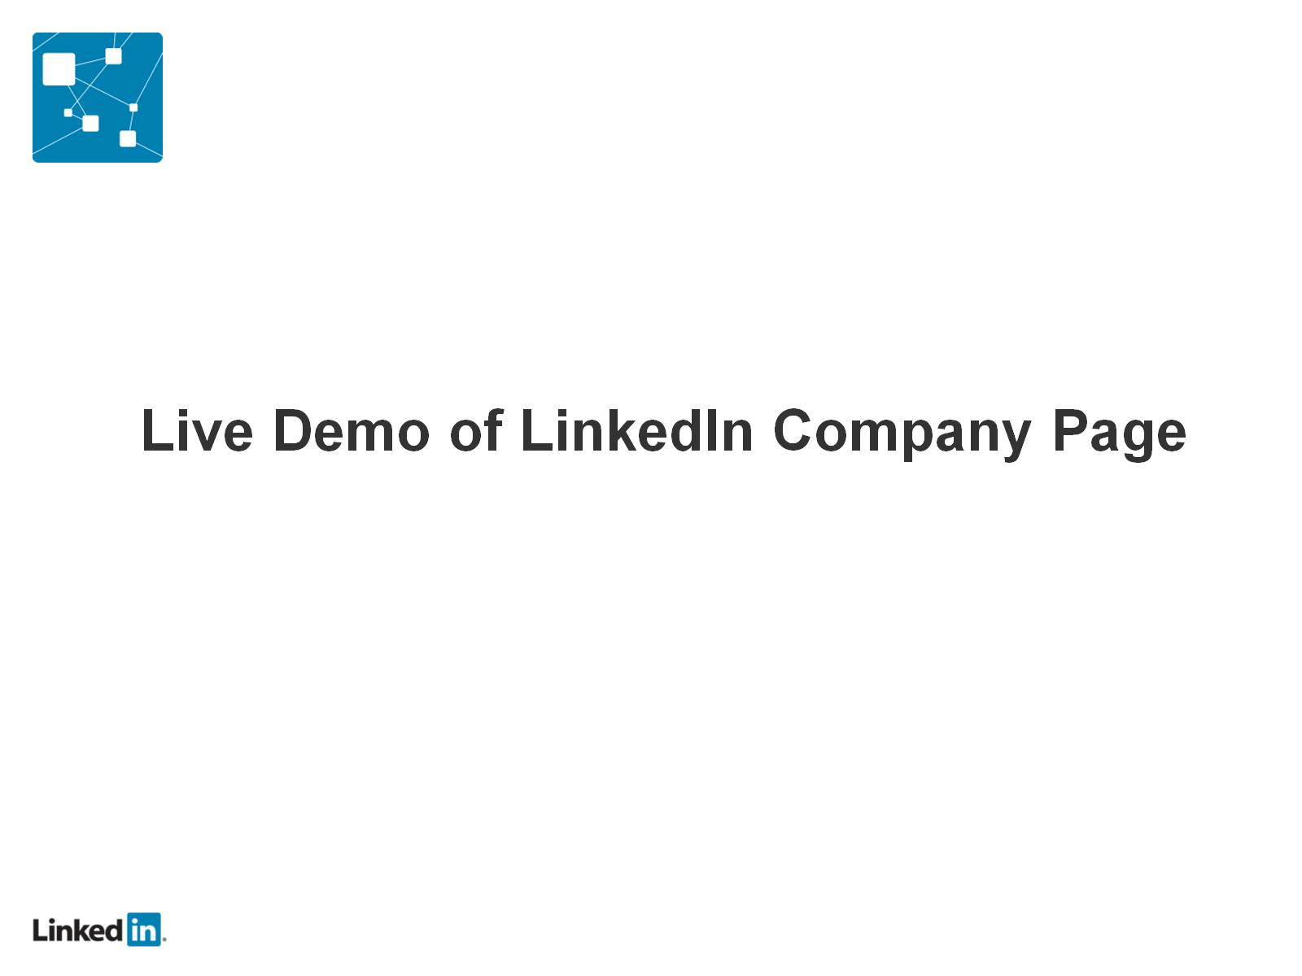

Slide 42
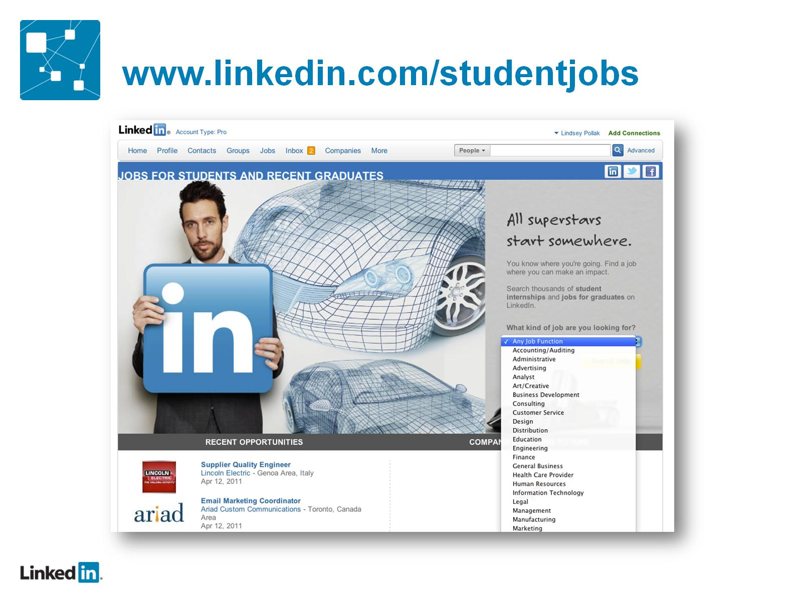

Slide 43
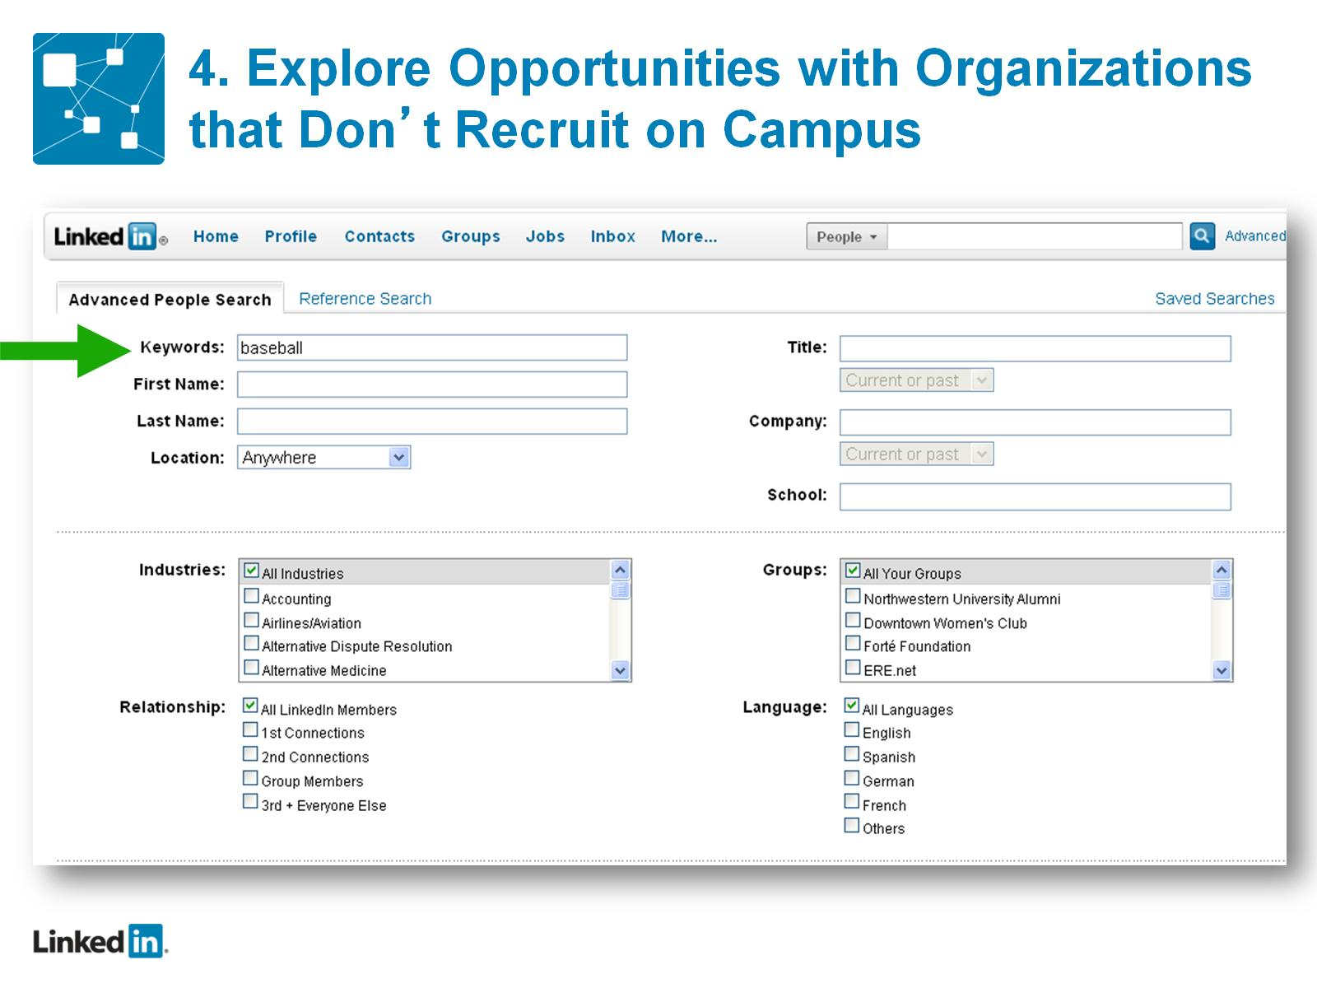
4. Explore Opportunities with Organizations that Don’t Recruit on Campus

Slide 44
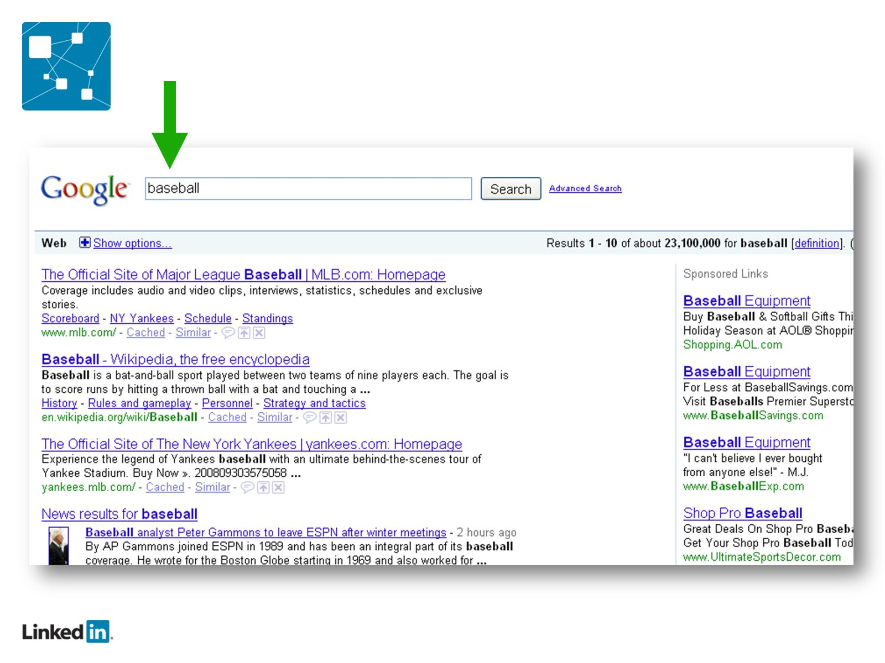

Slide 45
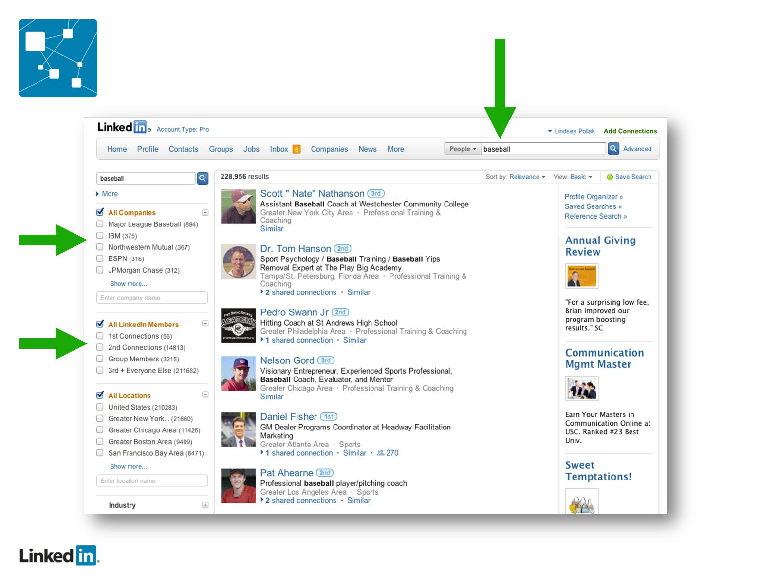

Slide 46
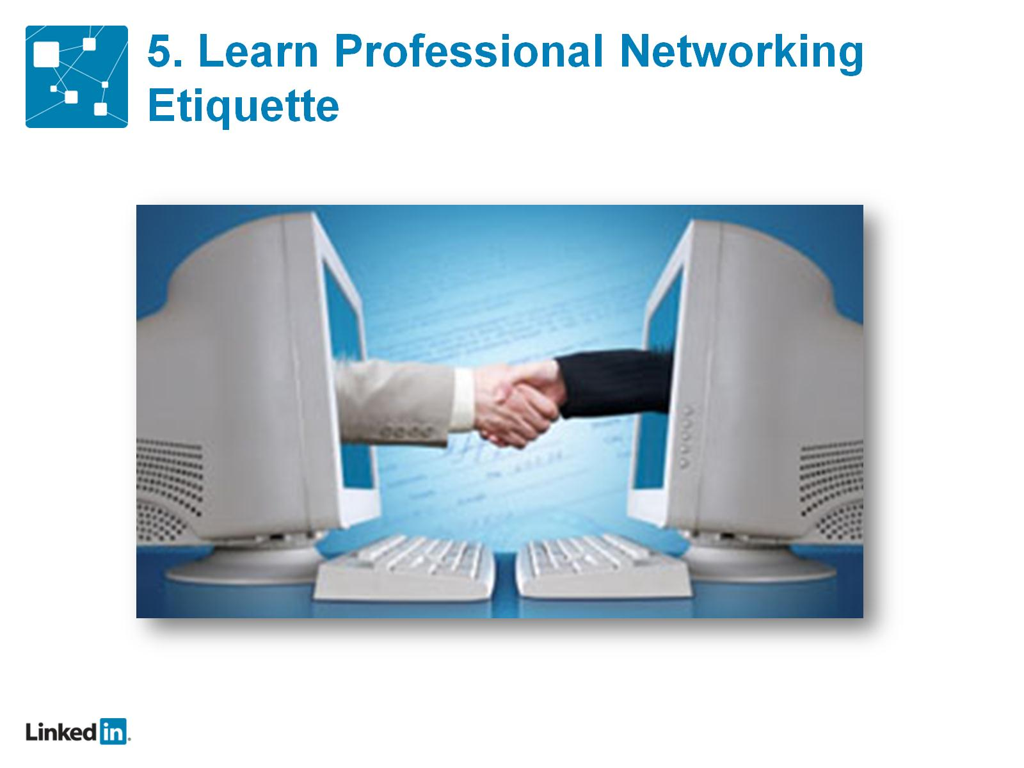
5. Learn Professional Networking Etiquette

Slide 47
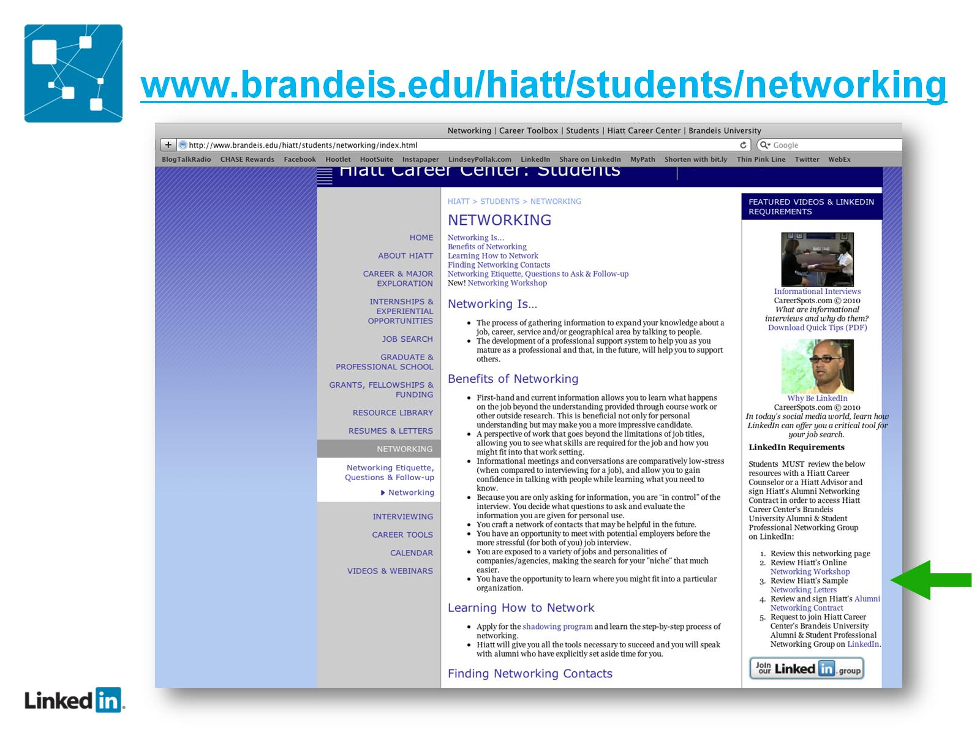

Slide 48
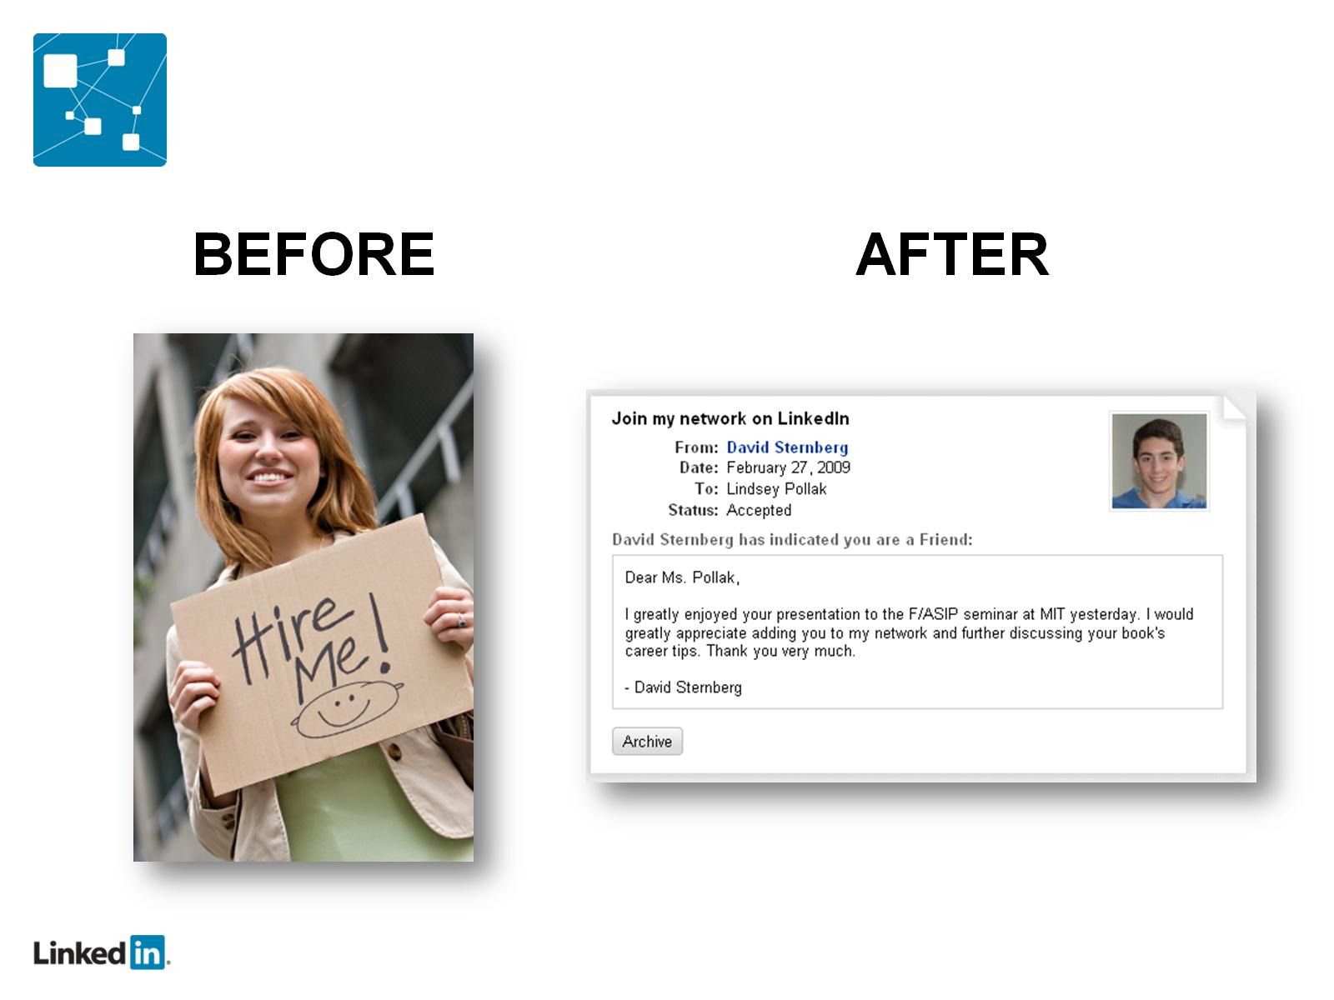

Slide 49
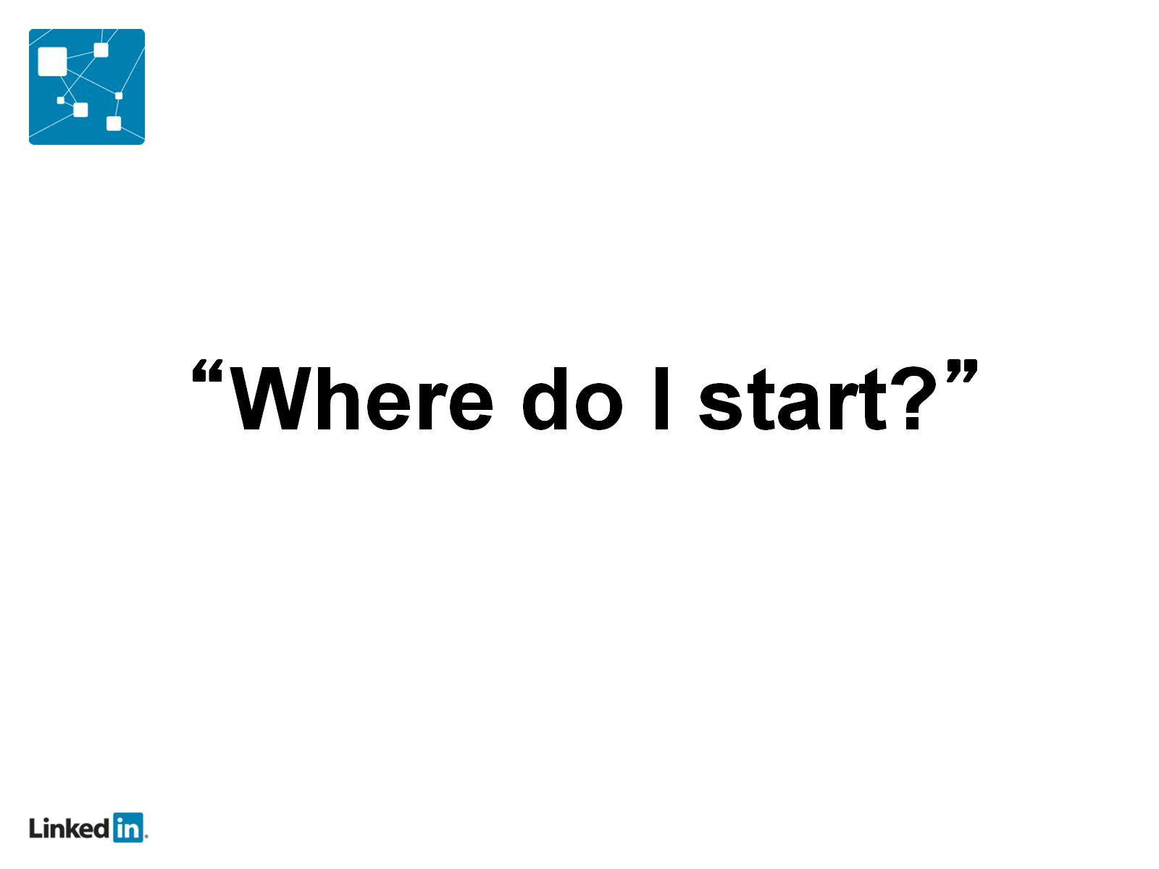

Slide 50
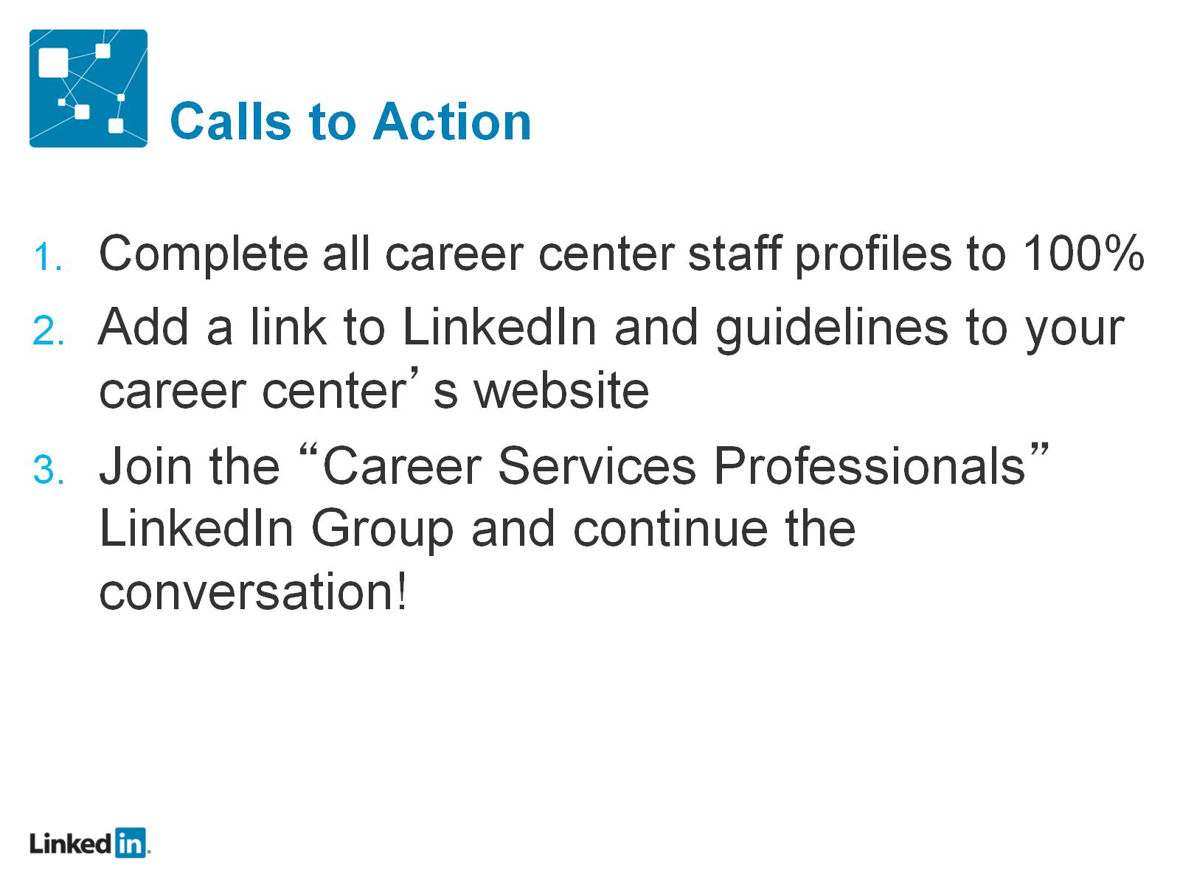
Calls to Action

Slide 51


Slide 52
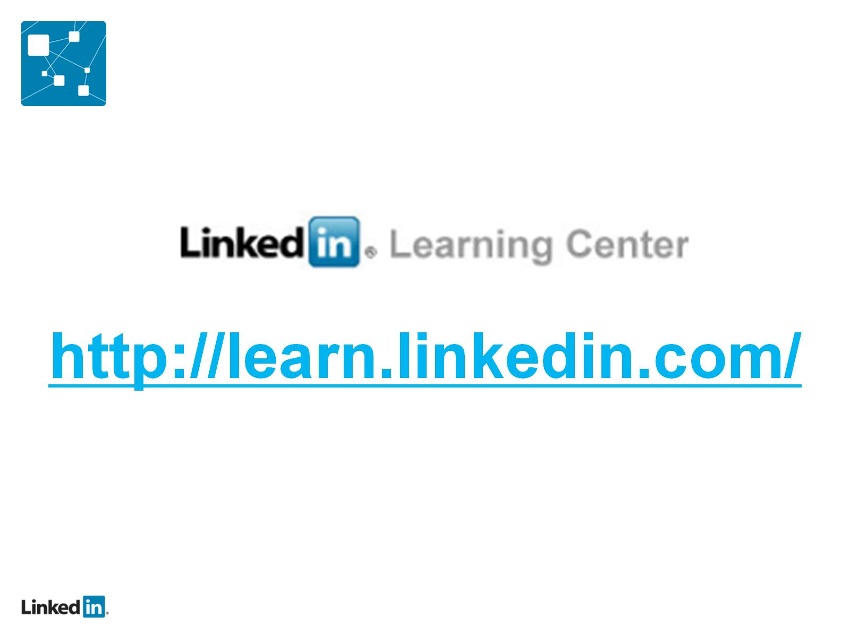

Slide 53
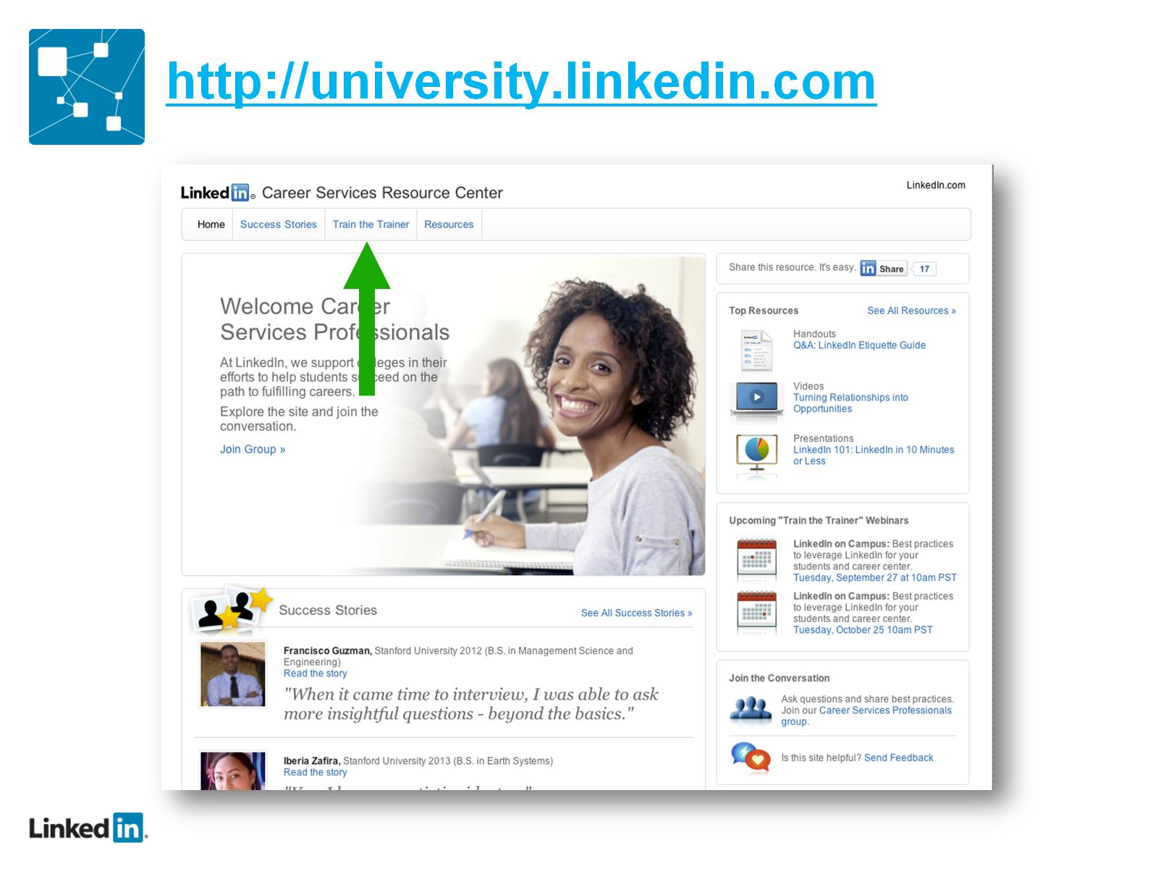
http://university.linkedin.com

